Slide 1
New Retirement Rules 2022

Slide 2
Agenda
  Module One: Predictable Economic Outcomes
  Module Two: Social Security Collection Strategies
  Module Three: IRA and 401(k) Tax Management Strategies
  Module Four: Tax Advantaged Income Strategies after Recent Law Changes
  Module Five: Planning Strategies for the Current Economy
  Module Six: Estate Planning and Asset Protection Strategies
  Module Seven: Investing For and In Retirement

Slide 3
You'll Receive These Free Reports:
  Social Security Maximization Report
  Fee and Drawdown Analysis Report
  IRA and 401(k) Tax Analysis
  New Retirement Rules Income Sourcing Map
  New Retirement Rules Allocation Map

Slide 4
Hello my name is
Who Are We?
Notes:
Shameless plug 2- company background
Fee-based advisor
Couldn’t sell you a mutual fund, stock or bond if we wanted to

Slide 5
Hello my name is
About the Presenter….
Notes:
Shameless Plug 3 - radio Show
13 years……….
What I’ve learned…
2002 – what did market do?
Advisors told clients – stay in for the long haul
Social Security integration

Slide 6
Two Important Lessons
I’ve Learned:
Lesson One:
No One Cares As Much About Your Money As You Do

Slide 7
Lesson Two:
A Very Important
Management Principle……..
“Inspect What You Expect”

Slide 8
My Motivation in the “New Retirement Rules” Class:
Give you information and a perspective you may not have to help you inspect what you expect in your financial situation.
Notes:
I found out that this is what happened.
After losing confidence in the attorney I’d originally hired, I retained a different attorney.
That’s when I learned that the original attorney had deliberately ignored requests for information and the government had no choice but to take legal action that could have been completely avoided had the original lawyer just done what I’d hired him to do.
I can only assume the original lawyer’s motivation was that litigation pays a lawyer better than providing information.
Once the government lawyer’s got the information, the legal action was dismissed. But only after major expense and lots of headaches.
And, in true government form, it took about three years to get everything dropped.

Slide 9
Module One:
Predictable Outcomes
Module One –
Topic One
  What Is Money?
  What is Currency?
  What is the Difference?

Slide 10
Definitions
Currency: Medium of Exchange; Used in Commerce to Buy and Sell
Money: Good Store of Value Over Time

Slide 11
Let’s Go Back in Time to 1913
The Federal Reserve became the nation’s third central bank.
The Federal Reserve is not a government agency. It is a group of private bankers that control monetary policy.

Slide 12
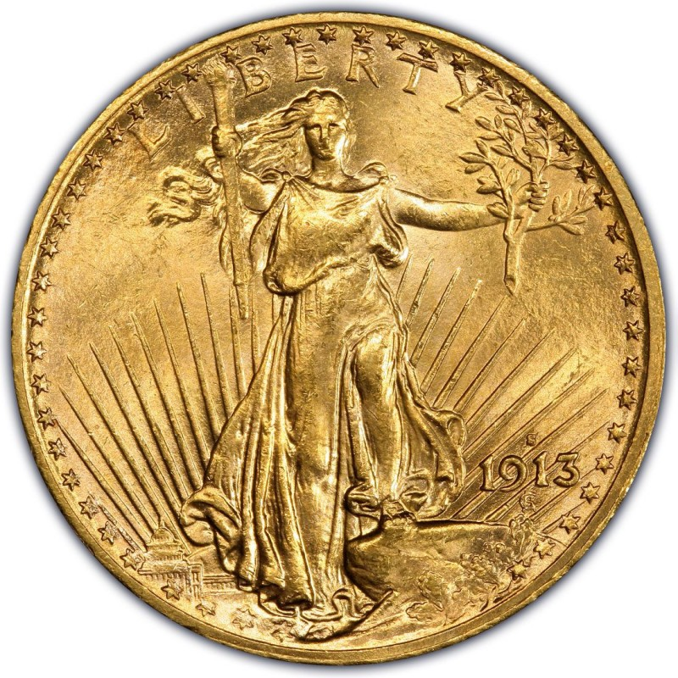
Let’s Go Back in Time to 1913
In 1913, a $20 gold piece was currency.
This gold piece contained one ounce of gold and could purchase $20 in goods and/or services.

Slide 13
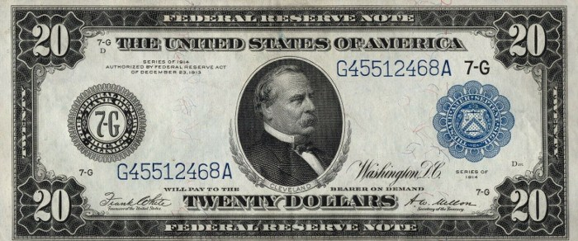
Let’s Go Back in Time to 1913
This federal reserve note, issued in 1914, had the same purchasing power as the $20 gold piece.
It could be exchanged for the
gold piece at par.
Both the gold piece and
the federal reserve note
were currency.

Slide 14
Let’s Go Back in Time to 1913

Slide 15
Let’s Go Back in Time to 1913
Today, the $20 Federal Reserve Note has $20 in purchasing power.
The $20 gold piece has more than $2,000 in purchasing power.
The Federal Reserve Note was currency; the $20 gold piece was money.

Slide 16
Example
In 1964, Coins Minted in the United States Were Largely Comprised of Silver.
Every $100 in Face Represented 72 Ounces of Silver i.e.:
  100 Silver Dollars
  200 Half Dollars
  400 Quarters
  1000 Dimes

Slide 17
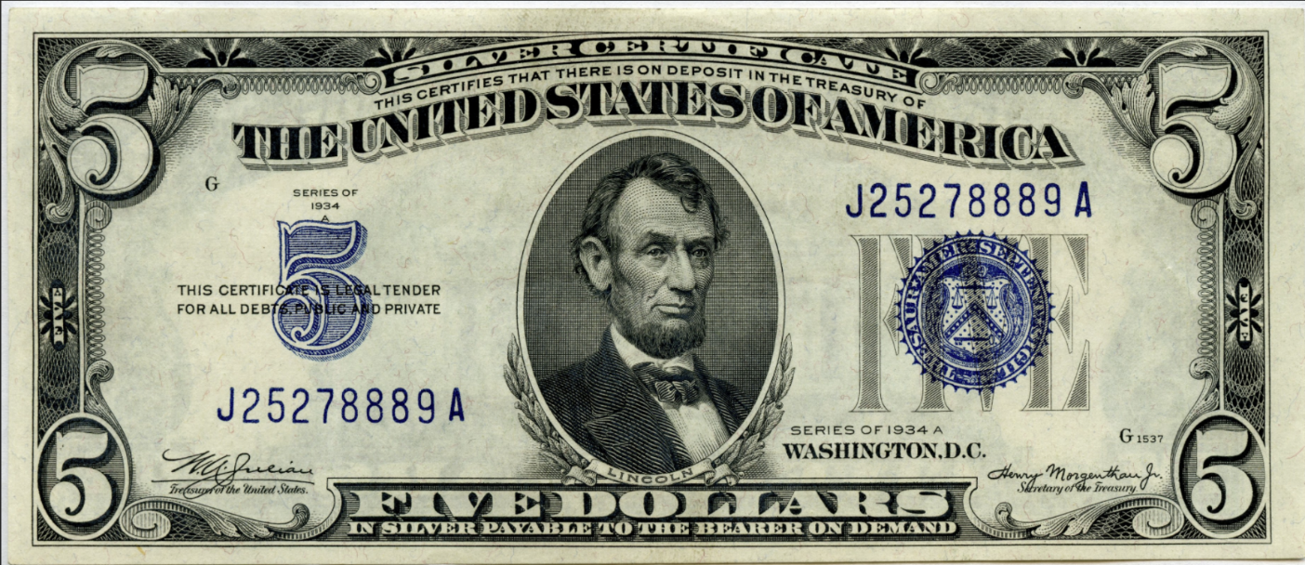
Example
At that time, silver certificates also circulated. These silver certificates were redeemable for the coins containing silver.

Slide 18
Example
In 1965, US coins no longer contained silver. Instead, coins were comprised of near worthless alloys.
In 1964, a $5 silver certificate and 5 silver dollars had exactly the same purchasing power.
Today, a $5 silver certificate has $5 in purchasing power and 5 silver dollars have purchasing power of about $100.

Slide 19
Example
The $5 silver certificate was Currency; the 5 silver dollars were Money.
Currency: Medium of Exchange; Used in Commerce to Buy and Sell
Money: Good Store of Value Over Time

Slide 20
Essential Concept Vital to Retirement Planning in Today’s Environment
Presently, currency and money are NOT the same thing.
This skews economic data, financial markets and the investing environment.

Slide 21
The Current Monetary Policy
IMPORTANT CONCEPT: SINCE 1971……….
Today’s Currency
is Debt.

Slide 22
An Important Anniversary
August 15, 1971
The Link Between the US Dollar and Gold Was Eliminated Making the US Dollar a Fiat Currency
Fiat Currency: Currency by Decree

Slide 23

An Important Anniversary – Nixon 8-15-1971

Slide 24

An Important Anniversary – Nixon 8-15-1971

Slide 25
An Important Anniversary
Two Things Richard Nixon said were not true:
The temporary suspension of converting US Dollars to Gold turned out to be permanent
The dollar has not maintained purchasing power for the ‘overwhelming majority’ of Americans who purchase American made products

Slide 26
The Current Monetary Policy
Beginning in 1971, US Dollars were loaned into existence.
Beginning in 1971, US Dollars went from being an asset, redeemable for gold to debt.

Slide 27
Current Bank Reserve Requirements
According to the Federal Reserve’s website, a $100 deposit into one bank can expand up to $1000 with a 10% reserve requirement. If the reserve requirement is increased to 20%, the banking system can only expand that $100 deposit into $500.
*Source: New York Federal Reserve Bank website.

Slide 28
This is a “money multiplier” affect or a “money throttle”. When there is too much inflation and economic expansion needs to slow, the money throttle is pulled back by raising interest rates and reserve requirements. When economic expansion is needed, the money throttle is engaged by reducing interest rates and reserve requirements.

Slide 29
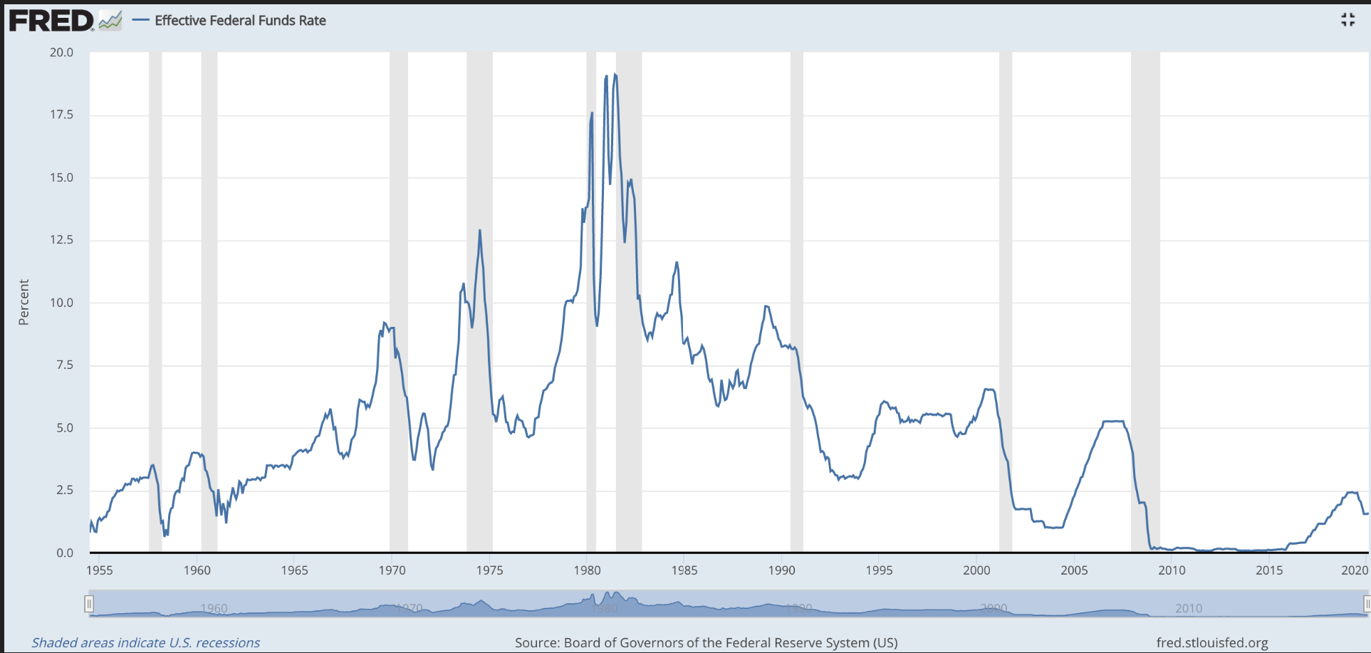
Fed Funds Rate

Slide 30
The Current Monetary Policy
After the financial crisis, interest rates were reduced to zero with little effect.
That is when the Federal Reserve began quantitative easing which is simply currency creation.

Slide 31
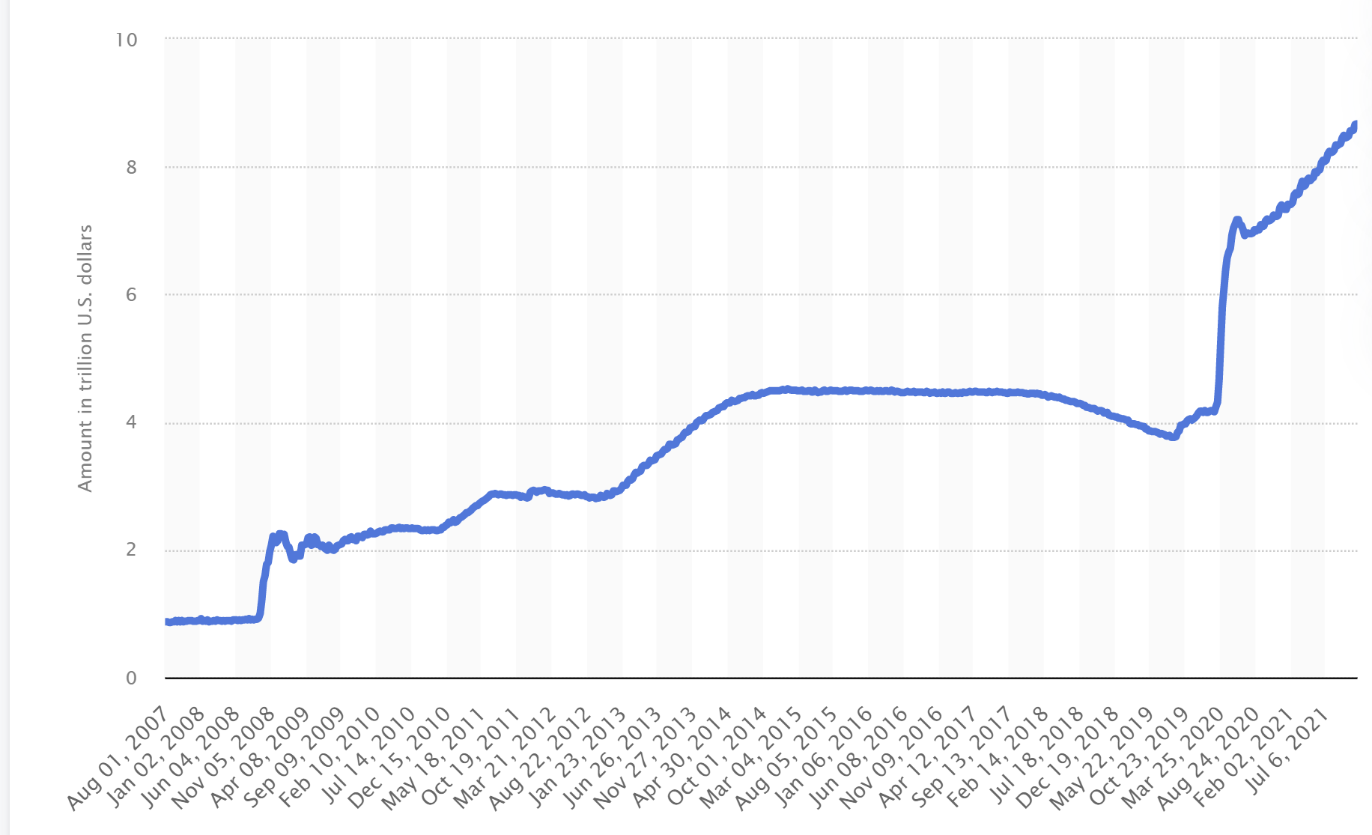
The Current Monetary Policy
Federal Reserve Balance Sheet
2007-2021
$1trillion to nearly $9 trillion

Slide 32

Inflation
An expansion of the currency supply.

Slide 33
Deflation
A contraction of the currency supply.
Since currency is debt, when debt goes unpaid, the currency supply contracts

Slide 34
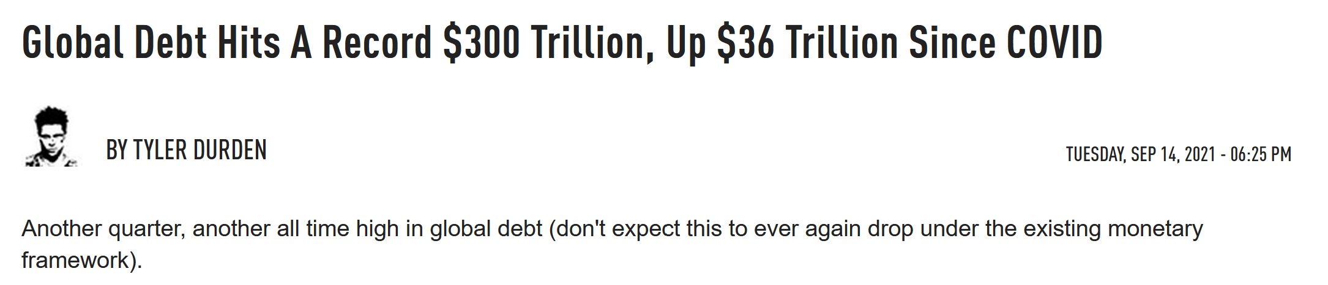
Debt Levels

Slide 35
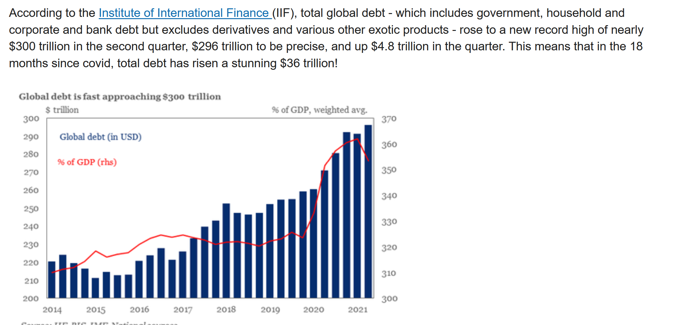
Debt Levels

Slide 36
Why Excessive Debt Leads to Deflation Example
Let’s assume that a banker loans Mr. Jones money to buy a house and the amount of the loan is $80,000.
The value of the house on which Mr. Jones borrows the money is $100,000.

Slide 37
Why Excessive Debt Leads to Deflation Example
Now, a few years later, due to dramatic declines in the value of real estate, Mr. Jones has a home worth $60,000 and decides to quit making payments on the home because he owes more on the home than the home is worth.
Now the bank owns the home since the home collateralized the loan the bank made to Mr. Jones.

Slide 38
Why Excessive Debt Leads to Deflation Example
The house the bank owns is worth $60,000, but the bank is owed $80,000.
The $20,000 difference is money that disappears from the financial system.
When debt levels are too high to be paid, deflation is the inevitable outcome at some point

Slide 39
Debt Levels
World central bankers are creating currency to stave off a deflationary crash like the world endured during the Great Depression of the 1930’s.

Slide 40
Thomas Jefferson Warned Us
“If the American people ever allow private banks to control the issue of their currency, first by inflation then by deflation, the banks and corporations that will grow up around them will deprive the people of all property until their children wake up homeless on the very continent their fathers conquered.”

Slide 41
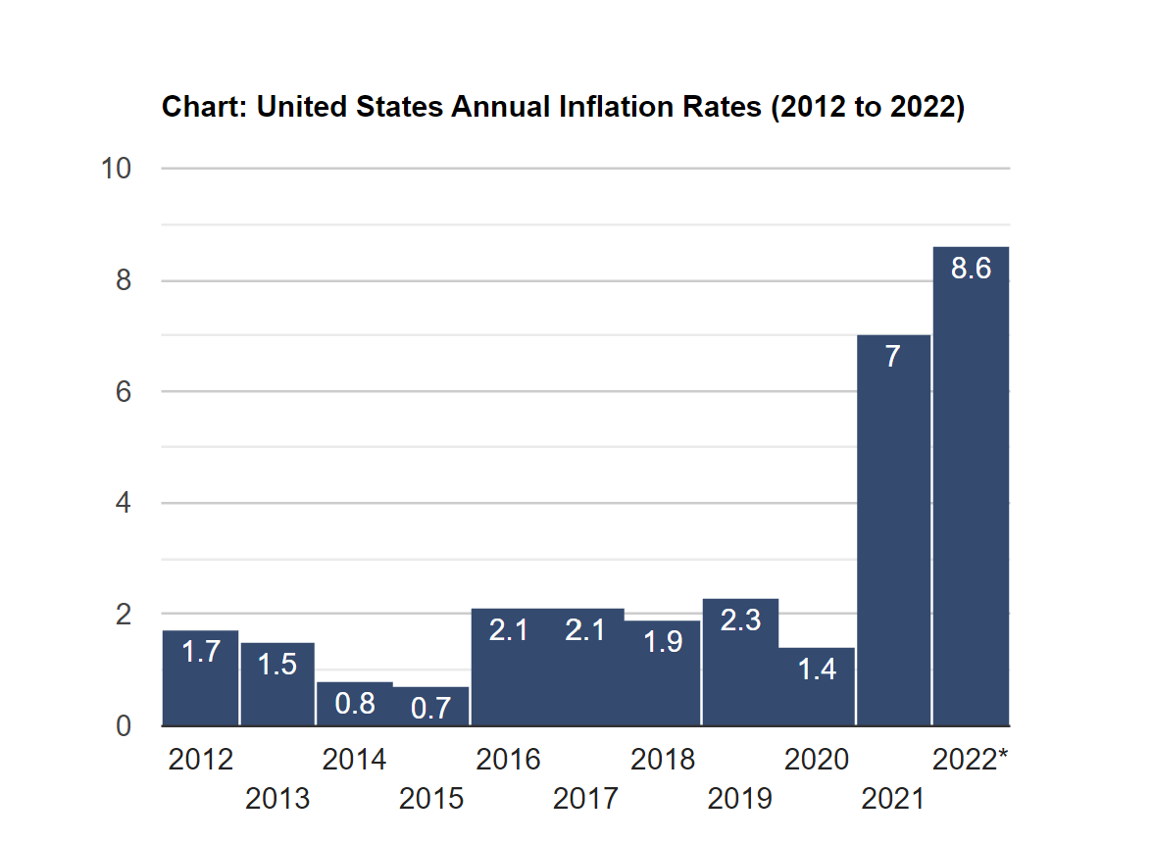
Debt Levels Dictate Deflation Will Come
But first, as Mr. Jefferson predicted, we are now seeing inflation….
The Official Inflation Rate

Slide 42
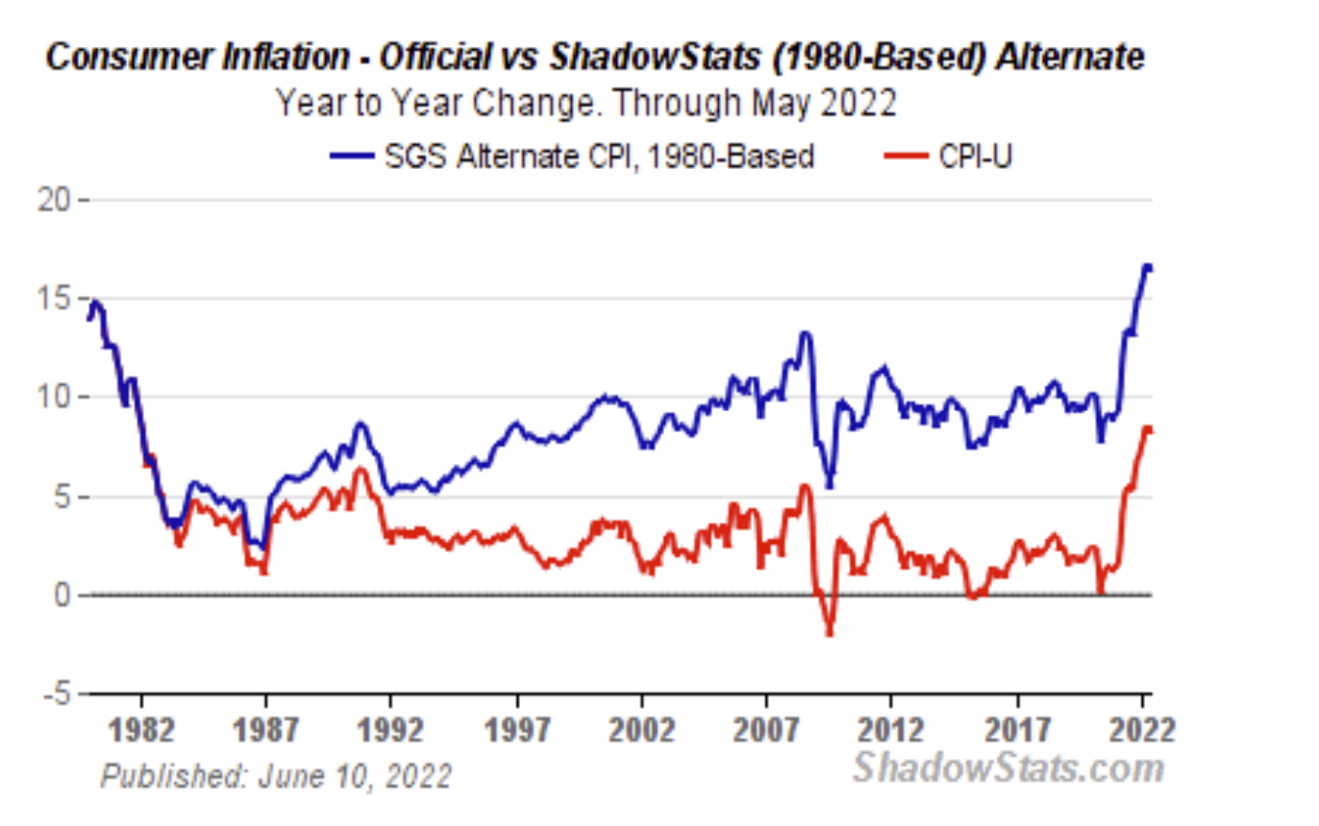
Debt Levels Dictate Deflation Will Come
But first, as Mr. Jefferson predicted, we are now seeing inflation….
The Real Inflation Rate
Courtesy www.ShadowStats.com

Slide 43
The Federal Reserve Has Three Choices – All Poor
1. Cease currency creation which will quickly lead the excess debt driven, deflationary collapse. In order for the Federal Reserve to cease currency creation, the federal budget will need to be balanced.

Slide 44
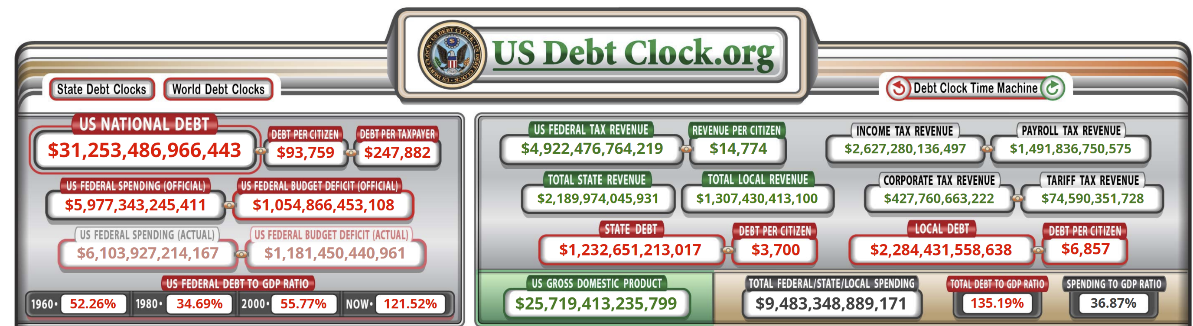
The Federal Reserve Has Three Choices – All Poor

Slide 45
The Federal Reserve Has Three Choices – All Poor
Budget Balancing Math
  Approximate Prior Deficit = $3 Trillion
  Number of Taxpayers = 126 Million
  Deficit per Taxpayer = $23,810 Annually
  Average Tax Liability per Tax Return = $9,118
American taxpayers would need to increase the taxes they pay by 261% to balance the budget.
(Source: https://www.fool.com/retirement/2016/10/31/heres-what-the-average-american-pays-in-taxes.aspx)

Slide 46
The Federal Reserve Has Three Choices – All Poor
Example: A taxpayer filing a joint income tax return with $120,000 in taxable income currently pays taxes of:
Social Security/ Medicare Tax | $ 9,180
Federal Income Tax (Std. Deduction) | $12,375
State Income Tax (MI Resident) | $ 4,033
Total Tax | $25,588
To balance the Federal Budget, Every Taxpayer would need to increase their tax payments by 261%.

Slide 47
The Federal Reserve Has Three Choices – All Poor
Example: To Balance the Budget.
To balance the Federal Budget, every taxpayer would need to increase their tax payments by 261%. But that still does not pay down the debt or solve the underfunded liabilities of Social Security and Medicare. These programs are underfunded significantly, by well over $150 trillion combined. The total fiscal gap of the United States is more than $200 trillion.¹ To solve these fiscal problems, each American taxpayer would need to come up with $1,587,000 in addition to paying the much higher taxes illustrated here.
Social Security/ Medicare Tax | $ 9,180
Federal Income Tax (Std. Deduction) | $32,299
State Income Tax (MI Resident) | $ 4,033
Total Tax | $45,512
^{1.} https://kotlikoff.net/wp-content/uploads/2019/03/The-2019-U.S.-Fiscal-Gap-Calculated-by-Laurence-Kotlikoff-and-Nils-Lehr.pdf)

Slide 48
The Federal Reserve Has Three Choices – All Poor
As noted, to solve these fiscal problems, each American taxpayer would need to come up with $1,587,000 in addition to paying the much higher taxes illustrated.
If the $1,587,000 in additional liability per taxpayer is amortized over 30 years at 3% interest, the additional liability per taxpayer is $80,292 per year.
Here’s what that does to the reasonably affluent taxpayer with $120,000 in household income we’ve been using as an example.
Example:
To Balance the Budget, Pay Down Debt and Fund Unfunded Liabilities
Social Security/Medicare Tax $ 9,180
Federal Income Tax (Std. Deduction) $ 32,299
State Income Tax (MI Resident) $ 4,033
Total Tax $ 45,512
Additional Payment for Debt $ 80,292
Total $125,804

Slide 49

The Federal Reserve Has Three Choices – All Poor
What about a Billionaire Tax?
Confiscating 100% of the Wealth of Billionaires Covers the Budget Deficit for 1.3 Years and Does Nothing to Pay Down Debt or Fund Unfunded Liabilities

Slide 50
The Federal Reserve Has Three Choices – All Poor
2.) The other way to balance the federal budget is to cut Federal spending across the board by 41%.
Once spending was cut 41% to balance the budget, additional cuts would need to be made to close the fiscal gap.
Given that the fiscal gap is over $200 trillion, if the fiscal gap were to be amortized over 30 years at 3%, the resulting annual payment would be more than $10 trillion.

Slide 51
The Federal Reserve Has Three Choices – All Poor
After spending is cut 41% to balance the budget, where does one find another $10 trillion annually to pay down debt and fund unfunded liabilities?

Slide 52
The Federal Reserve Has Three Choices – All Poor
3. Continue currency creation until there is a currency crisis at which point spending will have to be reined in to restore confidence in the currency. At that point the deflationary collapse will kick in.

Slide 53
The Federal Reserve Has Three Choices – All Poor
It seems obvious that we are now on that path.
Currency creation is leading to inflation which will likely worsen in the near term. This will be followed by a deflationary collapse.
This predictable pattern has repeated itself time and time again throughout history because human behavior and the collective behavior of politicians is predictable.

Slide 54
The Currency-Money Cycle
Hard Money
Is Currency
Many times in history this cycle has been evident.
Fiat Currency Failure
Paper Currency with a Link to Hard Money
Fiat Currency (No Link to Hard Money)
How does this transformation to a Fiat Currency Often Occur?

Slide 55
Debt Excesses
Faced with 3 choices, which of these options do you think many politicians in every century have chosen?
Raise Taxes?
Cut Spending?
Print Currency?

Slide 56
Historical Examples of Inflation and Deflation
Roman Empire
France in the early 1700’s under John Law
Colonial America
Weimar Germany

Slide 57
The Roman Empire
When studying the Roman Empire, one learns that the Roman Emperors kept the military on their side by continually increasing soldier pay.
As soldier pay kept increasing, it became difficult to raise the taxes necessary to fund the military.
Sources: Southern Utah University http://www.suu.edu/faculty/bostick/Sample%20Essays/Fall%20of%20Roman%20Empire.htm
About.com
http://ancienthistory.about.com/gi/o.htm?zi=1/XJ&zTi=1&sdn=ancienthistory&cdn=education&tm=157&f=00&su=p284.13.342.ip_&tt=2&bt=1&bts=1&zu=http%3A//mappinghistory.uoregon.edu/english/EU/EU08-03.html

Slide 58
The Roman Empire
In order to fund government spending the policymakers of the Roman Empire had 3 options
  Raise taxes
  Cut spending (including military pay)
  Print currency
Which option do you think they chose?

Slide 59
The Roman Empire
While paper money was not in use at the time, the Roman Emperors began to reduce the silver content of the Denarius the equivalent of money printing.
In 1 AD, the Denarius was about 90% pure silver and a Roman soldier earned about 200 Denarius annually.

Slide 60
The Roman Empire
By AD 250, the Denarius was a fiat currency, containing no silver and a Roman soldier earned about 600 Denarius per year providing evidence that money printing leads to inflation.
The Roman Empire continued its decline and eventually fell; the Denarius failed as a currency.

Slide 61
France Under John Law
John Law was France’s Central Banker in the early part of the 18th century.
He was appointed to this position after Louis the 14th died leaving France deep in debt.
Coins containing precious metal were being used as currency when Louis the 14th died. Shortly after Louis died, the French leaders had to figure out how to pay the debt.

Slide 62
France Under John Law
They had three choices:
  Raise taxes
  Cut spending
  Print currency
Which option do you think they chose?

Slide 63
France Under John Law
The coinage began to be debased, just like during the Roman Empire.
Newly minted coins contained precious metal content that was 20% less than coins minted previously
This made French citizens hoard the old coins which were more valuable. The government passed a law that made hoarding the coins illegal, punishable by imprisonment.

Slide 64
France Under John Law
John Law sprung to action.
He began to issue paper currency that he guaranteed could be exchanged at any time for the coins containing the precious metals.
This made the paper currency more popular than the coins since the paper currency was easier to use.
It didn’t take long for Law to collect most of the coins, leaving mostly paper currency circulating.

Slide 65
France Under John Law
The French controlled a colony in what would eventually be the United States from the mouth of the Mississippi River all the way north to Canada.
Law began to sell shares in a company that controlled all trade with this “New World” and France. This company was called The Mississippi Company.

Slide 66
France Under John Law
Law devised a very clever method to get rid of French Government debt. He allowed investors holding French Government debt to trade their securities for equity in The Mississippi Company.
Investors bit hard. Shares in the Mississippi Company began to soar in value.

Slide 67
France Under John Law
Before long, French citizens were literally fighting for the chance to buy shares in The Mississippi Company. The price of the shares rose rapidly.
Meanwhile, paper currency continued to be printed. It seemed that prosperity was everywhere. Luxury items were flying off the shelf in Paris. Real estate prices were booming.

Slide 68
France Under John Law
As the currency printing continued, some French citizens began to lose confidence in the paper currency and requested that their paper be redeemed for the coins with precious metal content.
A run on the bank ensued. The French Government couldn’t meet the demand for the coins containing precious metals since they had printed too much paper currency.

Slide 69
France Under John Law
In a last-ditch effort to avoid financial collapse, the French Government passed a law that stated the coins were worth only 95% of the paper currency.
The public didn’t buy it and the demand to exchange the paper currency for coins intensified.
Law had no choice but to make it illegal to own the coins just like Franklin Roosevelt did during the Great Depression with gold.

Slide 70
France Under John Law
Law closed the borders to the country and sent orders to coach houses to refuse fresh horses to anyone traveling out of the country until their bags were inspected.
A short time later, the French financial system collapsed. Gold and silver were reinstituted as money. It took 80 years for the French to use paper currency again.

Slide 71
Remember The Currency-Money Cycle?
Hard Money
Is Currency
John Law’s France confirms it.
Fiat Currency Failure
Paper Currency with a Link to Hard Money
Fiat Currency (No Link to Hard Money)

Slide 72
Colonial America
It surprises a lot of people to learn that the United States has already experienced one currency failure in its early history.
About the time of the Revolutionary War, on June 22, 1775, the United Colonies’ Congress issued $2 million in credit notes.
Source: http://www.ehow.com/about_5315424_history-continental-currency.html

Slide 73
Colonial America
These paper credit notes were to be used as currency and were nothing more than a promise to pay the holder of the notes back out of future tax revenues; there was no link to gold or silver.
These paper credit notes, known as Continentals, caused massive inflation and ended up having very little fiscal value.
Source: http://www.ehow.com/about_5315424_history-continental-currency.html

Slide 74
Colonial America
The first President of the United States, George Washington, commented that a wagonload of currency would hardly buy a wagonload of provisions.
The young fiat currency eventually failed and after the Treaty of Paris was signed in 1783 ending the Revolutionary War, a debt-ridden young country went into an economic depression as a result of the massive debt levels that existed at the time.
Source: http://www.ehow.com/about_5315424_history-continental-currency.html

Slide 75
Colonial America
Economic hard times lead to civil unrest and this time was no different.
In 1787, rebellion broke out in Massachusetts which eventually led to the Articles of Confederation being abandoned in favor of the Federal Constitution which created a more centralized Federal Government.
Source: http://www.ehow.com/about_5315424_history-continental-currency.html

Slide 76
Colonial America
Then, in 1791, the Mint Act was passed which made gold and silver the currency of the land.
Interestingly, it was 70 years before the US used fiat currency again when Lincoln printed currency to finance the Civil War.
Source: http://www.ehow.com/about_5315424_history-continental-currency.html

Slide 77
Remember The Currency-Money Cycle?
Hard Money
Is Currency
Early US history confirms it.
Fiat Currency Failure
Paper Currency with a Link to Hard Money
Fiat Currency (No Link to Hard Money)

Slide 78
Weimar Germany
If you have ever studied history, you have probably studied the hyperinflation of Germany after World War I. Interestingly, many folks only remember half the story.
Germany hoped that it would quickly win the war and reap bounty from the nations it conquered, which – to the government – justified the use of the printing press to fund the war.
Source: “Business Insider” October 18, 2012

Slide 79
Weimar Germany
It didn’t take too long for this currency printing to create inflation.
Due to the economy, many German soldiers began to desert the military.
As a result, Germany lost the war.
Source: “Business Insider” October 18, 2012

Slide 80
Weimar Germany
The Treaty of Versailles that ended the conflict imposed huge reparations on Germany. The payment demands made of Germany were so large that Germany could never realistically pay with ‘honest’ money.
So, the currency printing continued.
Source: “Business Insider” October 18, 2012

Slide 81
Weimar Germany
By September 1920, prices were 12 times as high as they had been before the war.
By the autumn of 1920, the strains on the economy in the wake of the war were apparent, but employment was still fairly strong.
Nevertheless, prices were rising as a direct result of this currency printing.
Source: “Business Insider” October 18, 2012

Slide 82
Weimar Germany
Food had accounted for half the family budget immediately after the war, but now nearly three-quarters of the average family's income went for food.
Faced with a bill that it could not pay from a war it couldn’t afford, Germany continued currency printing at an even faster pace.
Source: “Business Insider” October 18, 2012

Slide 83
Weimar Germany
Germans everywhere were doing everything they could to convert their marks into other currencies.
It didn’t take long for the cost of basic staples to become out of reach for German consumers as the mark plunged.
Source: “Business Insider” October 18, 2012

Slide 84
Weimar Germany
At 35,000 to the pound at Christmas 1922, the mark fell and at the end of January 1923 touched 227,500 to the pound
At the end of September of 1923, the German Chancellor declared a state of emergency and put Germany under military rule.
Source: “Business Insider” October 18, 2012

Slide 85
Weimar Germany
Finally, in November of 1923, the German government took action to stabilize the currency. The German government set up the Rentenbank to issue a new currency, the Rentenmark, which would be backed by land and industrial goods.
Finally, a month after the Rentenmark was introduced, everyday Germans were able to feed themselves again.
Source: “Business Insider” October 18, 2012

Slide 86
Weimar Germany
However, after a recovery in 1924, a whole new crisis hit Germany in 1925 – mass unemployment.
The strengthened currency and subsiding hyperinflationary pressures once again brought German industry to its knees as several firms plunged into bankruptcy, and unemployment soared. Deflation set in.
Source: “Business Insider” October 18, 2012

Slide 87
Remember The Currency-Money Cycle?
Hard Money
Is Currency
Weimar Germany confirms it.
Fiat Currency Failure
Paper Currency with a Link to Hard Money
Fiat Currency (No Link to Hard Money)

Slide 88

Worldwide the Move Away from the US Dollar Has Begun

Slide 89


Slide 90
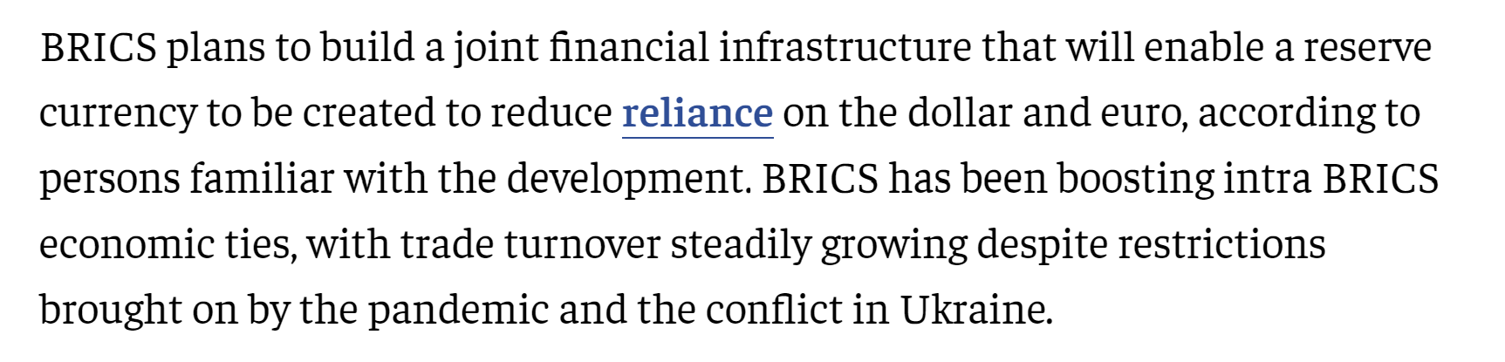

Slide 91

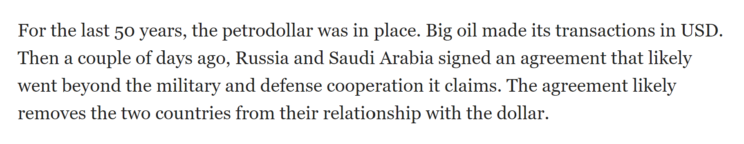

Slide 92
Thomas Jefferson
“If the American people ever allow private banks to control the issue of their currency, first by inflation, then by deflation, the banks and corporations that will grow up around them will deprive the people of all property until their children wake up homeless on the continent their Fathers conquered.”

Slide 93
The remaining Modules will be presented in light of these economic conditions.

Slide 94
Module Two: Social Security Collection Options
How Social Security Works

Slide 95
Let’s begin with some definitions.

Slide 96
Social Security
Normal Retirement Age
Birth Year | Normal Retirement Age
1943-1954 | 66
1955 | 66 and 2 months
1956 | 66 and 4 months
1957 | 66 and 6 months
1958 | 66 and 8 months
1959 | 66 and 10 months
1960 & later | 67

Slide 97
Drawing Social Security Earlier
Than Your Normal Retirement Age
Normal Retirement Age | Discount at 62
66 | 25%
66 and 2 months | 25.83%
66 and 4 months | 26.67%
66 and 6 months | 27.50%
66 and 8 months | 28.33%
66 and 10 months | 29.17%
67 | 30%

Slide 98
If you elect to defer collecting Social Security benefits after you have reached your normal retirement age, your retirement benefits will increase by .67% per month or 8% per year.

Slide 99
      This increase is simple interest only.
For example, if your normal retirement age is 66, your age 70 benefit will be 132% of your age 66 benefit.
Delayed benefit credits from Social Security are only available through age 70.

Slide 100
Social Security:
The New Rules and the Fading Opportunity

Slide 101
      Spousal Benefit
You can collect half of your spouse’s primary insurance amount at your normal retirement age provided your spouse is collecting benefits.

Slide 102
A ”restricted application” for spousal benefit can only be collected if you were born prior to January 2, 1954.

Slide 103
If you were born January 2, 1954 or later, you cannot file a “restricted application” to collect only a spousal benefit. When you file for Social Security benefits, you will be “deemed” to be applying for the highest benefit for which you are eligible. (There are still valid maximization strategies to use however.)

Slide 104
That means if you turn 66 January 1, 2020 or before, you may be able to file a ”restricted application” to draw only spousal benefits.
As you draw a spousal benefit, your primary insurance amount increases at a rate of 8% per year.

Slide 105
Social Security
Collection Case Studies

Slide 106
Important Note
The case studies presented here are for illustrative purposes only and should not be deemed to be Social Security collection advice. The best Social Security collection strategy for your own, individual situation is dependent on individual facts and circumstances and assumptions which may not be accurate. The assumptions used in these case studies assume a life expectancy to age 85 and a 3% annual inflation rate.

Slide 107

Case Study Number One:
  Janet is 66 years and 4 months old in 2022, which is her Normal Retirement Age.
  She can collect Social Security Benefits of $25,435 annually at her present age.

Slide 108
If Janet were to wait to collect Social Security Benefits until the following ages here is what her corresponding benefit might be:
Age | Annual Benefit
67 | $27,139
68 | $28,957
69 | $31,139
70 | $33,321
Assumes no adjustment for a cost of living increase.

Slide 109
Let’s assume Janet lives to age 85 and compare total benefits collected based on a collection start date of age 66 yrs and 4 months and a collection start date of age 70.
Total Benefits Collected
if starting at age 66 yrs and 4 months:
$479,120
Total Benefits Collected
if starting at age 70:
$499,815

Slide 110
Now, let’s look at the “breakeven point” in non-inflation adjusted dollars
Additional annual benefit at age 70
$7,886
Benefits collected from age 66 yrs and 4 mos to age 70
$97,500
Years to
break even
12.36

Slide 111

Case Study Number Two:
  David turned 66 years old on January 1, 2020
  Sarah is 65 years old
  Sarah began collecting Social Security benefits at age 62.
  David can file a restricted application to collect Social Security Benefits.

Slide 112
David can collect spousal benefits until he is 70 years old.

Slide 113
  By collecting spousal benefits, David’s primary benefit continues to grow at a rate of .67% in monthly simple to age 70.
  This is a “free” spousal benefit of which many folks are unaware.

Slide 114
Let’s compare outcomes.
If David began collecting his own primary Social Security benefits at age 66 and Sarah continued to collect her benefits; their income from Social Security might look like this:
David’s Age | Sarah’s Age | David’s SS | Sarah’s SS | Total SS
66 | 65 | $29,989 | $18,252 | $48,241
67 | 66 | $29,989 | $18,252 | $48,241
68 | 67 | $29,989 | $18,252 | $48,241
69 | 68 | $29,989 | $18,252 | $48,214
70 | 69 | $29,989 | $18,252 | $48,241
71 | 70 | $29,989 | $18,252 | $48,241
Subsequent years’ income are the same. (Assumes no C.O.L.A.)

Slide 115
Let’s compare outcomes.
If David and Sarah use the maximization strategy, here is the potential outcome:
David’s Age | Sarah’s Age | David’s SS | Sarah’s SS | Total SS
66 | 65 | $12,101 | $18,252 | $30,353
67 | 66 | $12,101 | $18,252 | $30,353
68 | 67 | $12,101 | $18,252 | $30,353
69 | 68 | $12,101 | $18,252 | $30,353
70 | 69 | $39,586 | $18,252 | $57,838
71 | 70 | $39,586 | $18,252 | $57,838
Subsequent years’ income are the same. (Assumes no C.O.L.A.)

Slide 116
Summary
(Non-Inflation Adjusted Dollars)
Total income collected from David’s age 66 through Sarah’s age 85, assuming life expectancy to age 85 for both David and Sarah:
Non-maximized strategy
$994,809
Maximized strategy
$1,028,568

Slide 117

Case Study Number Three:
  Bob is 63 years old in 2022
  Molly is 61 years old in 2022
  Neither are eligible to collect a spousal benefit under the new rules.

Slide 118
If both Bob and Molly begin to collect their respective Social Security benefits at age 62, here are the amounts that they will collect:
 | Annual Benefit
Bob Age 62 | $24,102
Molly Age 62 | $19,593
Total | $43,695

Slide 119
Assuming a life expectancy to age 85 for both Bob and Molly and a 3% annual inflation rate, the Maximize My Social Security analysis program has Bob and Molly collecting benefits as follows:
 | Annual Benefit
Bob Age 70 | $40,221
Molly Age 68 and 4 months | $30,804
Total | $71,025

Slide 120
Let’s calculate Bob and Molly’s “Break Even Point”
Total collected by Molly’s age 85 if:
Both follow the proposed maximization strategy:
$1,144,394
Both collect
Social Security at age 62:
$1,018,642

Slide 121
Survivor Benefit
Maximized
$40,221
Age 62
$24,102

Slide 122
Social Security:
Taxation of Benefits

Slide 123
      When are Social Security Benefits Taxed?
  Some people have to pay federal income taxes on their Social Security when they have other substantial income (such as wages, self-employment, interest, dividends and other taxable income that must be reported on your tax return) in addition to your benefits.
      How are Social Security Benefits Taxed?
  No one pays federal income tax on more than 85 percent of his or her Social Security benefits based on internal revenue service (IRS) rules.
  If you file a federal tax return as an "individual" and your combined income is between $25,000 and $34,000, you may have to pay income tax on 50 percent of your benefits. More than $34,000, up to 85 percent of your benefits may be taxable.
  If you file a joint return, and you and your spouse have a combined income that is between $32,000 and $44,000, you may have to pay income tax on 50 percent of your benefits more than $44,000, up to 85 percent of your benefits may be taxable.
  If you are married and file a separate tax return, you probably will pay taxes on your benefits.
Source: socialsecurity.gov/planners/taxes

Slide 124

      Consider this
      Hypothetical Case:
John and Mary have a $500,000 CD earning
2.5% interest
  Bank CDs are FDIC insured and offer a fixed rate of return.

Slide 125
Here is what John and Mary’s tax return looks like:
Taxable Interest Income $12,500.00
Pension Income $18,800.00
IRA Distributions $ 8,300.00
Social Security Benefits $30,319.00
Taxable Social Security Benefits $15,146.00
Adjusted Gross Income $54,746.00
Deduction and Exemptions $24,000.00
Taxable Income $30,746.00
Tax $ 3,309.00

Slide 126
John and Mary invested
their $500,000 CD into 2 guaranteed, short term
annuity accounts.
It is important to understand that fixed annuities, unlike CD’s, are neither insured nor guaranteed by the FDIC, and that they may decline in value if surrendered prior to maturity, due to surrender or withdrawal charges. Annuities guarantees are based on the claims-paying ability of the issuing insurance company. For these reasons, it is important to work closely with your advisors to select the best annuity for your needs.

Slide 127
      Annuity account #1
$56,250
      Annuity account #2
$443,750
This illustration assumes that annuity account #1 and annuity account #2 are fixed rate annuities.

Slide 128
Taxation of Annuities
The taxation of annuity contracts and related payments can be complex and confusing. A complete discussion of all aspects of taxation of annuity distributions is beyond this presentation’s scope. For annuities with an immediate payout, every payment received consists of both income and return of invested capital. The latter is tax free, until the entire basis in the contract is recovered. Therefore, tax benefits can be realized as the full amount of income received is not typically taxed.
Annuity account #1 provides $12,500 per year in income for 5 years…
      90% tax free!
Assumes a rate of return of 3.5%. Includes return of initial principal contribution amount.

Slide 129
Annuity account #2 accumulates over 5 years:
Year 1
Year 2
Year 3
Year 4
Year 5
$457,063
$470,774
$484,898
$499,445
$514,428
Assumes a fixed annuity and a hypothetical net rate of return of 3%

Slide 130
Here is what John and Mary’s tax revised tax return looks like:
Taxable Interest Income $ 1,250.00
Pension Income $18,800.00
IRA Distributions $ 8,300.00
Social Security Benefits $30,319.00
Taxable Social Security Benefits $ 5,755.00
Adjusted Gross Income $34,105.00
Deduction and Exemptions $24,000.00
Taxable Income $10,105.00
Tax $ 1,011.00

Slide 131
After 5 years, John & Mary have $11,490 in additional income just from tax savings!!!

Slide 132
John and Mary may also reduce the amount of their Social Security subject to income tax.

Slide 133
Module Three:
Taxation of Benefits and Retirement Accounts

Slide 134
SECURE Act Is Now Law. This Changes Things
Some Highlights:
  RMD’s Begin at Age 72
  The Stretch Out IRA Is Dead
  SECURE Makes Roth Conversions More Attractive for Some Investors

Slide 135

In this example, we’ll consider the situation of Frank and Susan. They are both 66 years old.

Slide 136
They’ve done some preliminary planning and determined that they will need about $84,000 per year when they retire.

Slide 137
After conducting a Social Security maximization study, they determine that they can receive a combined $58,000 per year from Social Security upon retirement.

Slide 138
Frank and Susan have accumulated $1,200,000 in 401(k) plans at their employers. They will need to draw $26,000 per year from these assets to meet their desired income level.
$26,000
Needed
$34,000
Frank Social Security
$58,000
Total Benefits
$24,000
Susan Social Security

Slide 139
One look at Frank and Susan’s situation reveals that when they reach age 72, their required minimum distributions will exceed their income needs.

Slide 140
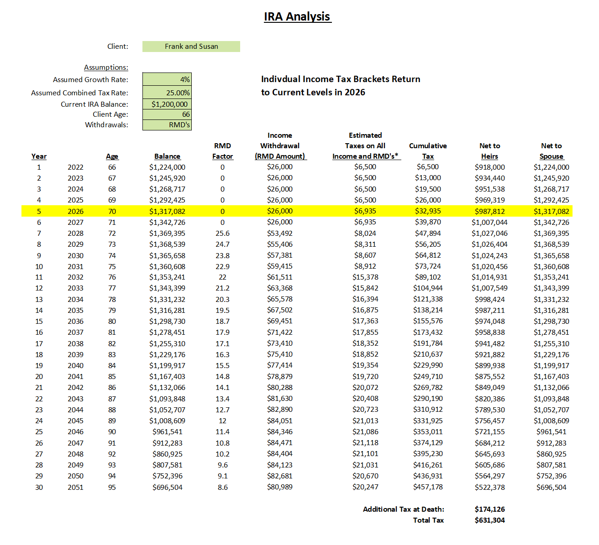
Income Frank and Susan will need during retirement followed by required minimum distributions.
Age 72
RMD’s
$53,492

Slide 141
Let’s examine how those withdrawals will affect Frank and Susan’s Social Security benefits when they reach age 72 (Now changed under the SECURE Act).

Slide 142
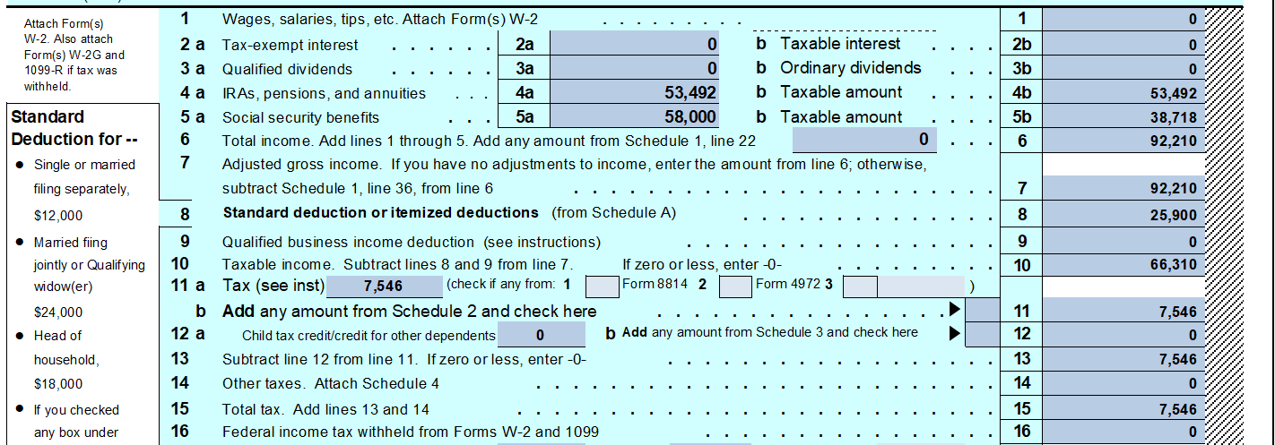
RMD’s $53,492
Taxable Social Security $38,718
Tax $7,546

Slide 143
Now, let’s review Frank and Susan’s tax return at their age 85 based on these assumptions.

Slide 144
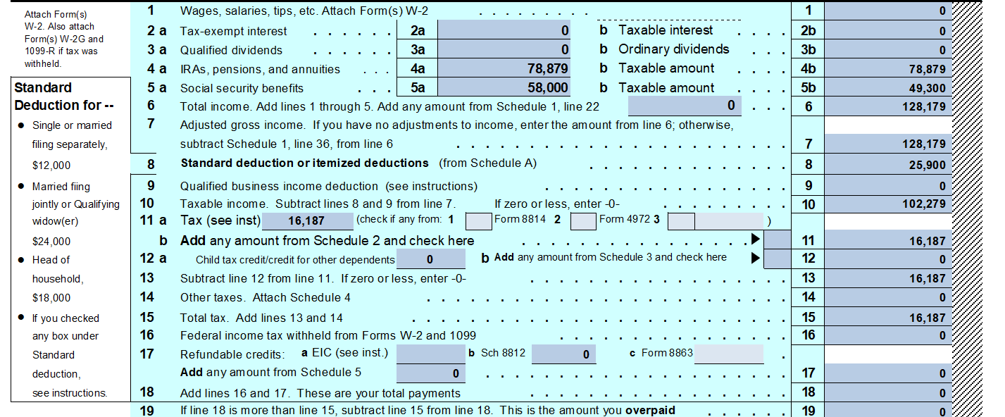
RMD’s $78,879
Taxable Social Security $49,300
Tax $16,187

Slide 145
Because of the level of IRA withdrawals that are required, Frank and Susan pay taxes on an ever- increasing portion of their Social Security benefits. Social Security taxes increase until 85% of Social Security Benefits Received are taxable.

Slide 146
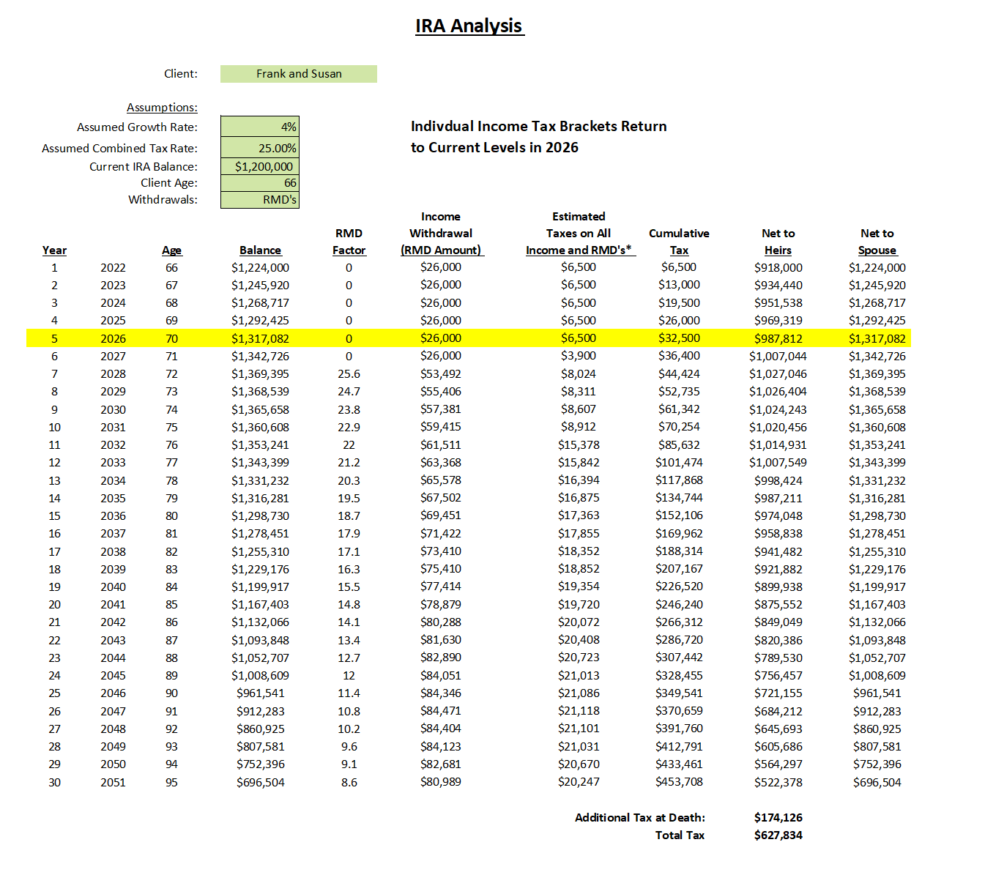
IRA Analysis

Slide 147
Now, let’s assume that Frank and Susan decide to do Roth IRA conversions or a similar strategy to reduce the total taxes they’ll pay over their lifetime.

Slide 148
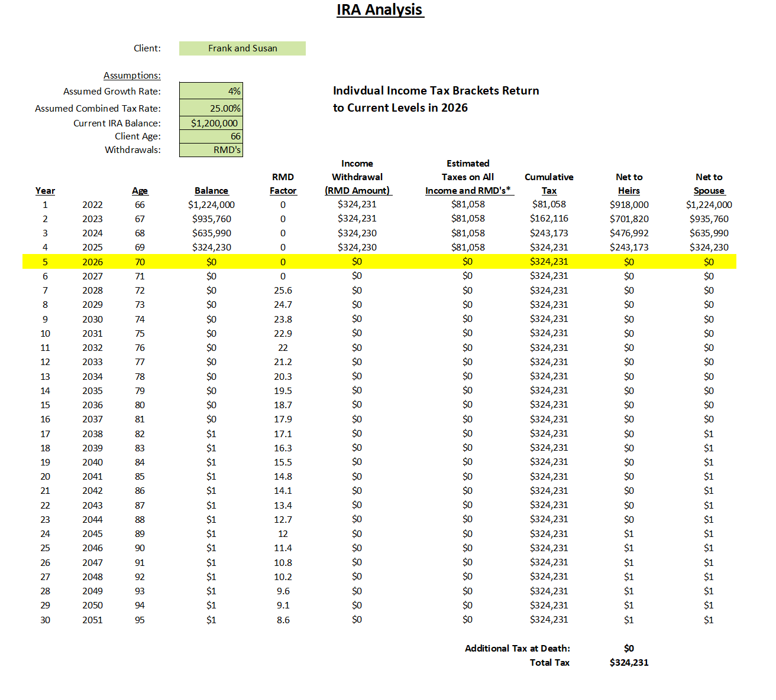

Slide 149
Regular IRA
Tax Free
Alternative
$627,384
$324,231
Here is the potential tax savings for Frank and Susan when the divorce themselves from the IRS when taking into account Social Security tax savings as well
Tax Savings
$303,153

Slide 150
Now let’s compare income tax returns at age 72.

Slide 151
Before
RMD’s $53,492
Taxable Social Security $38,718
Tax $7,546

Slide 152
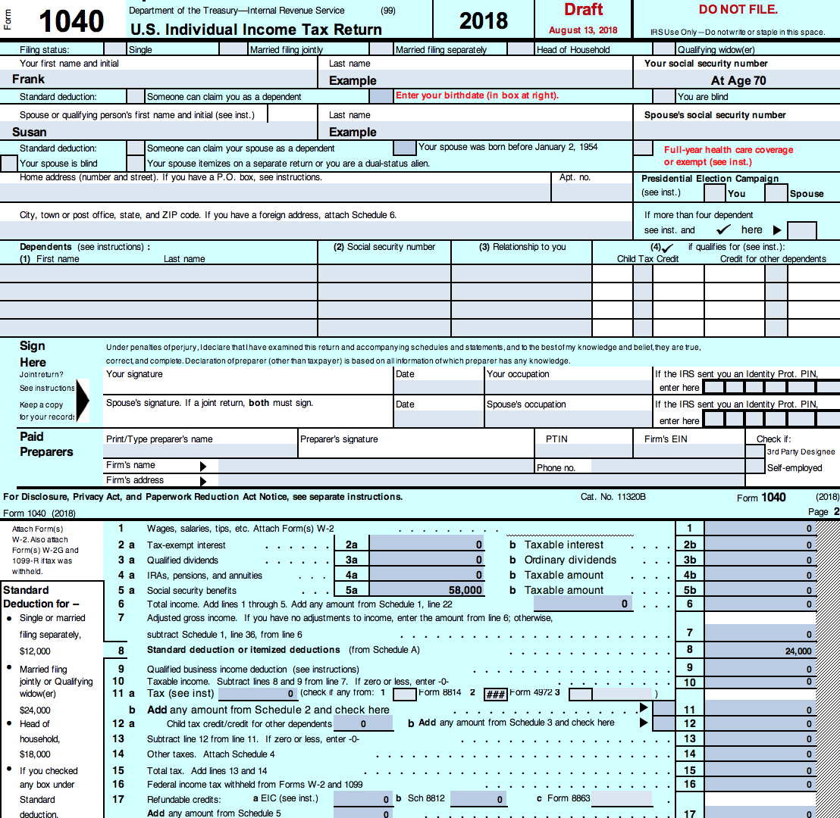
RMD’s $0
Taxable Social Security $0
Tax $0
After

Slide 153
Distributions from a Roth IRA or a properly designed guaranteed insurance contract are tax free and do not count in the formula that is used to determine how much of one’s Social Security is taxed.

Slide 154
How Roth Conversions Might Affect the Retirement Account When Frank and Susan’s Heirs Inherit It
  All Proceeds Must Be Distributed Within 10 Years
  Traditional IRA – Distributions are Taxable to Heirs
  Roth IRA – Distributions are Tax Free to Heirs

Slide 155
Module Four:
Income Planning

Slide 156
Income Planning Risk
A Threat to Income: Drawdown

Slide 157
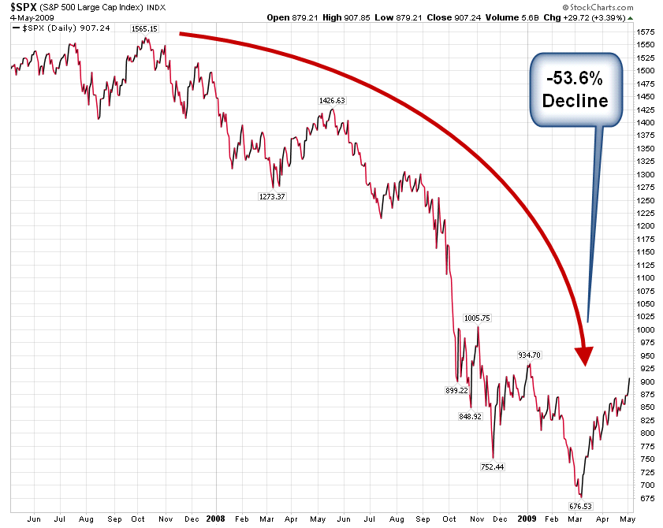
Why Managing Drawdown is Important
Buy and Hold Results

Slide 158
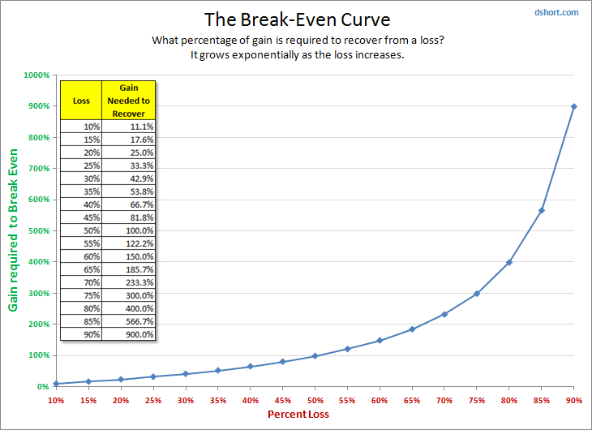
Why Managing Drawdown is Important

Slide 159
Do You Know the Drawdown Risk In Your Portfolio?

Slide 160
Income Planning Risk:
Excessive Fees in Investments
“Money Managers and Advisors
Get Paid Before You Do”

Slide 161
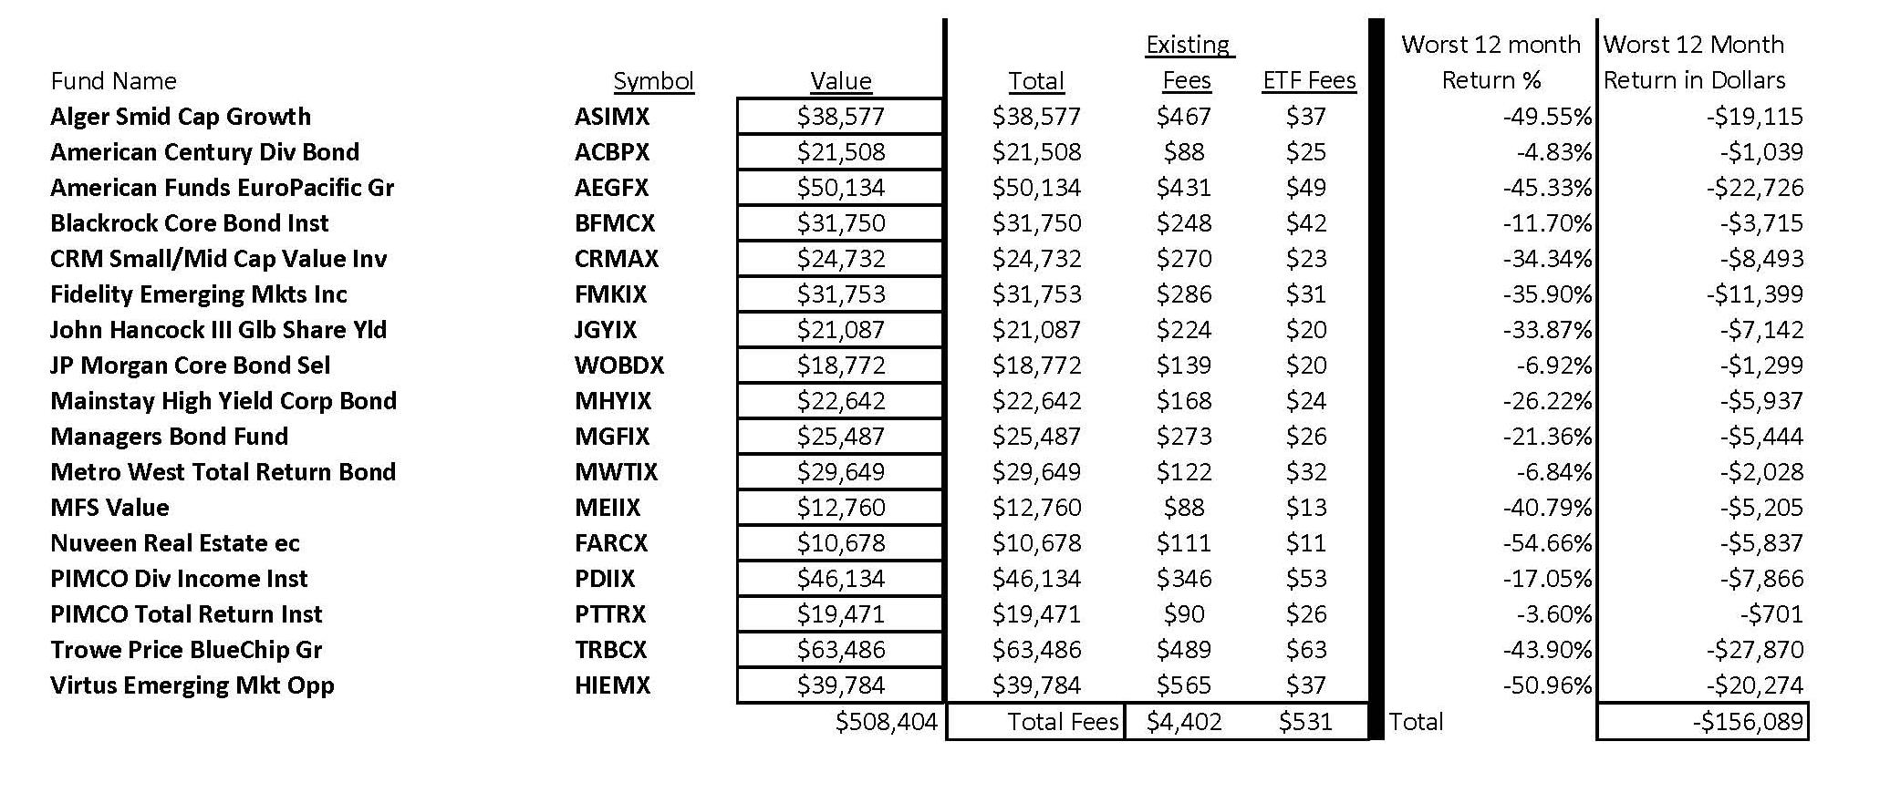
$508,404
$4,402
$-156,089

Slide 162
Additional Fee Paid to Broker/Advisor 1%
$5,084
Total
Fees
$9,486

Slide 163
Let’s Discuss the First
Three Free Reports:
  Social Security Maximization Report
  Fee and Drawdown Analysis Report
  IRA and 401(k) Tax Analysis
  New Retirement Rules Income Sourcing Map
  New Retirement Rules Allocation Map

Slide 164
What We Need to Prepare
These Reports:
  Social Security Earnings Statement
  Account Holdings with Amounts
  IRA Balances and Your Age(s)
  Your Tax Bracket

Slide 165


Slide 166
End of Class One
See You Next Week

Slide 167
Module Five:
Planning Strategies for the Current Economy

Slide 168
An Important Anniversary
August 15, 1971
The Link Between the US Dollar and Gold Was Eliminated Making the US Dollar a Fiat Currency
Fiat Currency: Currency by Decree

Slide 169
The Current Monetary Policy
IMPORTANT CONCEPT: SINCE 1971……….
Today’s Currency
is Debt.

Slide 170
Debt Levels

Slide 171
The Current Monetary Policy
Federal Reserve Balance Sheet
2007-2022
$1trillion to nearly $9 trillion

Slide 172
Inflation
An expansion of the currency supply.

Slide 173
Deflation
A contraction of the currency supply.
Since currency is debt, when debt goes unpaid, the currency supply contracts

Slide 174


Slide 175


Slide 176
Thomas Jefferson Warned Us
“If the American people ever allow private banks to control the issue of their currency, first by inflation then by deflation, the banks and corporations that will grow up around them will deprive the people of all property until their children wake up homeless on the very continent their fathers conquered.”

Slide 177
This Pattern Repeats Itself Throughout History
Inflation followed by Deflation
IMPORTANT: The level of inflation is determined by the currency system in use.

Slide 178
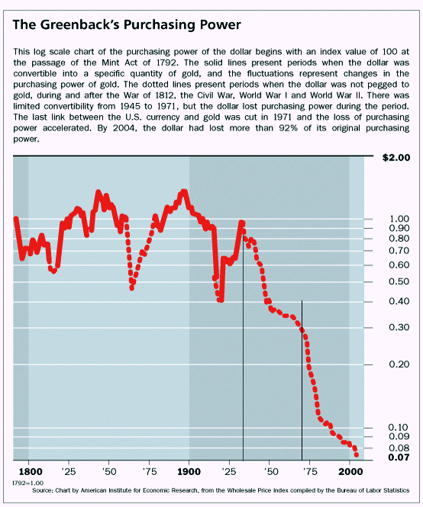
Take a look at the
purchasing power
of the US Dollar going back to 1791, when the nation’s first
central bank
was established:

Slide 179
Take a look at the
purchasing power
of the US Dollar going back to 1791, when the nation’s first
central bank
was established:

Slide 180
Take a look at the
purchasing power
of the US Dollar going back to 1791, when the nation’s first
central bank
was established:

Slide 181
Take a look at the
purchasing power
of the US Dollar going back to 1791, when the nation’s first
central bank
was established:
In each of these “currency creation” time frames, paper currency was linked to gold or circulated with gold.

Slide 182
Following the War of 1812, US policymakers were faced with 3 choices to pay war debt:
  Raise taxes
  Cut spending
  Print currency
What do you think they did?

Slide 183
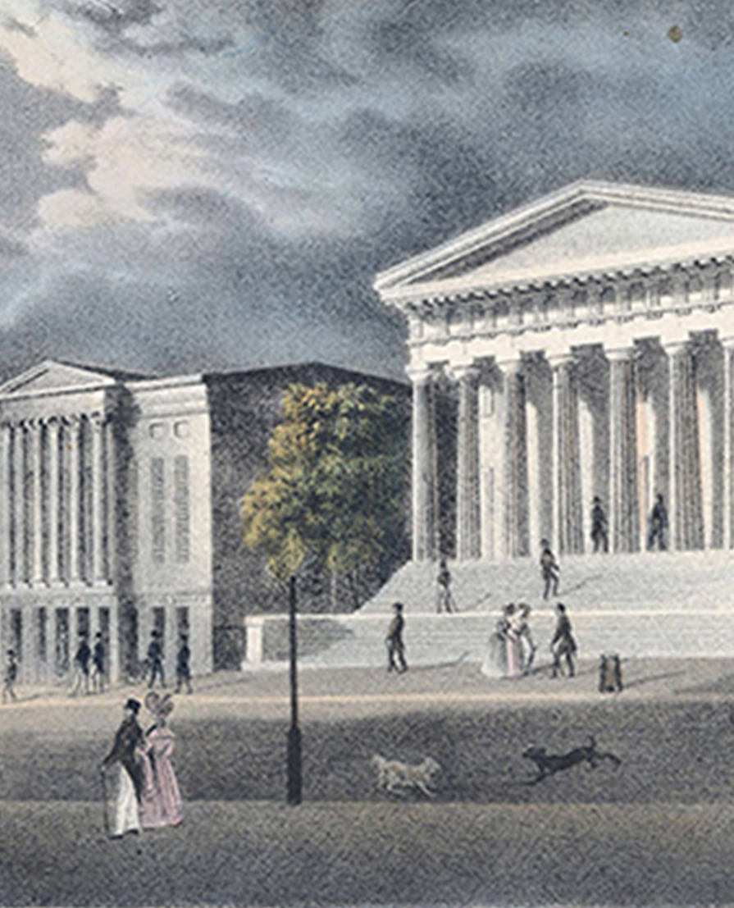
The Second Bank of the United States was chartered in 1817.
Source: Ludwig von Mises Institute

Slide 184
Article Excerpt Describing the Inflation-Deflation Episode of the 1820’s and 1830’s
After the demise of the Bank of the United States, state and wildcat banks grew rapidly during the 1830s. Funds were more easily available, and investors borrowed money at an incredible pace. Not only the small Western farmer, but merchants, manufacturers and traders also borrowed heavily. The business community, rather than paying off their debts and refinancing new ventures, anticipated greater returns if they invested their borrowed money in speculative enterprises -- investments that, they hoped, would greatly increase in value while they held them. Leading the list of speculative ventures were investments in the vast amounts of readily available cheap land.
Land offices throughout the country reported record sales as speculators invested for quick returns. Between 1834 and 1836, sales totaled 37 million acres. By 1836, sales were ten times greater than they were in 1830. “Land office business” was the order of the day.

Slide 185
Article Excerpt Describing the Inflation-Deflation Episode of the 1820’s and 1830’s
The speculative mania continued to spread, despite the Federal Government’s attempts to halt it, or at least to curb the speculative holding of large tracts of land.
Public land, although the most important facet of speculation, was by no means the only kind of land sold. Urban real estate was also caught up in this mania as values increased. A Hartford speculator related making 75% annually on an invest- ment of $1,000 in Michigan, where the boom was in high gear. Not only the Midwest witnessed wild speculation, valuation of real property increased in New York over 50% in five years. And even Maine timber lands tripled in price in just a few years.

Slide 186
The prosperity illusion ended with the Panic of 1837 when banks failed due to debt excesses and a deflationary depression set in.

Slide 187
President Lincoln and congress took the nation off the gold standard during the Civil War in order to finance the war.
In 1863 and 1864, National Banking Acts were passed into law. Until these acts were passed, only state banks existed, with the Federal Government having no control over them.
The National Banking Acts created nationally chartered banks. These nationally chartered banks had as assets gold, silver, and government debt, similar to the asset composition of the first central bank of the US we previously discussed. Each national bank could issue its own currency but was limited in the amount of currency it could print. Each national bank could only print currency to the extent it owned government debt to back the currency.

Slide 188
Article Excerpt Describing the Inflation-Deflation Episode of the 1860’s and 1870’s
Industry and trade had flourished beyond precedent during the first years after the war. In 1873 railroad mileage had doubled itself since 1860, and this was a prolific cause of rash speculation.
Stock prices soared. Mortgages were easy to get. Large banks were more than glad to make loans to developers. Half-built buildings were accepted as collateral for many of these mortgages because almost anyone could get credit. A housing bubble formed.
The era of high prices and business activity which had followed the war yielded its legitimate effect in an abnormal growth of the spirit of speculation. The inevitable consequence followed.

Slide 189
The prosperity illusion ended with the Long Depression of 1873 when banks failed due to debt excesses and a deflationary depression set in.

Slide 190
The nation’s third Central Bank, today’s Federal Reserve, was established in 1913.
One of the first things that the Federal Reserve did was to reduce the gold backing of the US Dollar to 40%. With only 40 cents on the dollar being backed by gold, the money supply expanded significantly.

Slide 191
Bubbles in the real estate market and the stock market formed before ultimately bursting.

Slide 192
Article Excerpt Describing the Inflation-Deflation Episode of the 1920’s and 1930’s
The famous stock market bubble of 1925–1929 has been closely analyzed. Less well known, and far less well documented, is the nationwide real estate bubble that began around 1921 and deflated around 1926.
In the 1920s, Florida was the site of a real estate bubble fueled by easy credit and advertisers promoting a lifestyle of sunshine and leisure. Contemporary accounts describe a collective madness that consumed Florida investors; city lots in Miami were bought and sold as many as 10 times in a single day.
The housing price downturn in 1926 led to a rise in the foreclosure rate. Foreclosures of residential properties also increased in 1926, rising steadily through the stock market bubble and peaking in 1933.

Slide 193
This Pattern Repeats Itself Throughout History
In each of these historic inflation-deflation cycles, currency was linked to gold in some manner.
That is not true today. Today there is no link; there are no ‘money rules’ which has allowed the Fed to create massive levels of new currency.
This is the only time in recorded history that every currency is pure fiat with no link to gold.
That has allowed for excesses unlike anything ever before seen.

Slide 194
Debt Levels

Slide 195
The Current Monetary Policy
Federal Reserve Balance Sheet
2007-2021
$1trillion to nearly $9 trillion

Slide 196


The goal of the Revenue Sourcing™ planning strategy is to protect assets from the inflation part of the cycle as well as the deflation part of the cycle.
These are unprecedented times and there are no guarantees.

Slide 197
Revenue Sourcing Steps
2. Allocation Map
1. Income Map

Slide 198
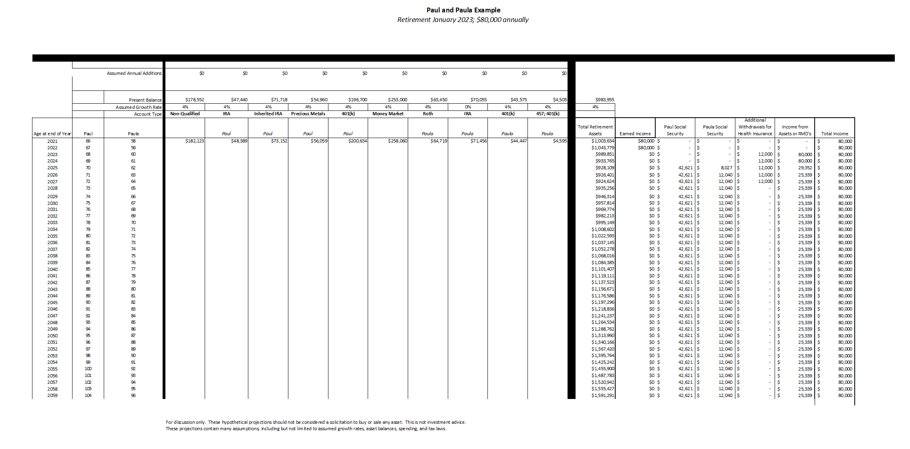

Slide 199
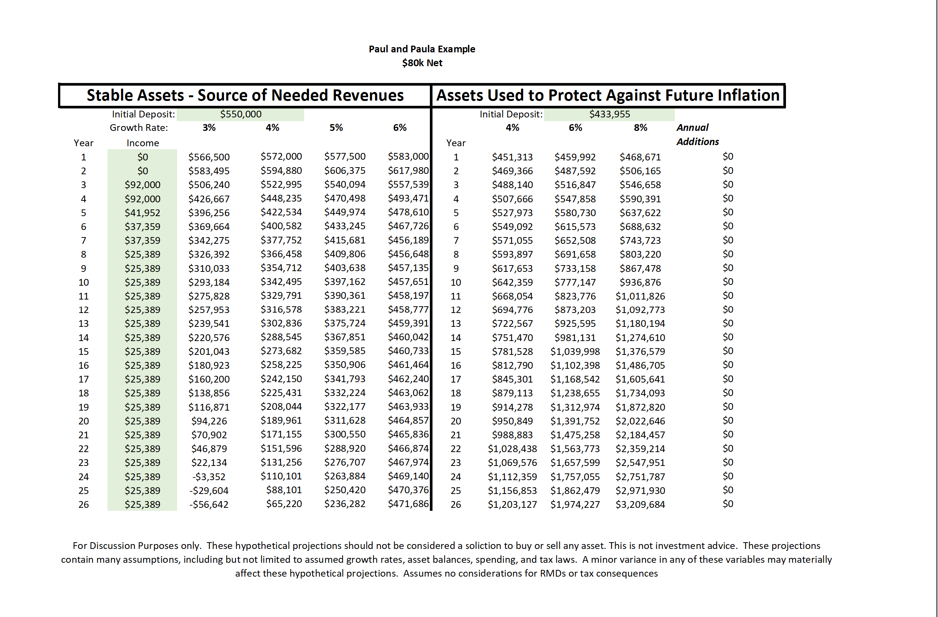

Slide 200
Stable Asset Bucket Objectives
Protect assets from deflationary fallout
Provide an income source that is stable
As tax-favored as possible

Slide 201
Inflation Protection Asset Bucket Objectives
100% Liquid
Contingency Assets; i.e. decline in purchasing power, large medical expense, major purchase, other emergency
As tax-favored as possible

Slide 202
Designing the Revenue Sourcing™ Income Map
Determine level of income desired
Determine most favorable Social Security collection option
If applicable, determine most favorable pension collection option
Determine level of income needed from investments
Analyze Feasibility

Slide 203
Determining Level of Income Desired
Start with Current Take Home Pay
Track Expenses Over a One-Year Time Frame and Add In Extras

Slide 204
Determine Most Favorable Social Security Collection Options

Slide 205
Remember Janet?
  Janet is 66 years and 4 months old in 2022, which is her Normal Retirement Age.
  She can collect Social Security Benefits of $25,435 annually at her present age.

Slide 206
If Janet were to wait to collect Social Security Benefits until the following ages here is what her corresponding benefit might be:
Age | Annual Benefit
67 | $27,139
68 | $28,957
69 | $31,139
70 | $33,321
Assumes no adjustment for a cost of living increase.

Slide 207
Let’s assume Janet lives to age 85 and compare total benefits collected based on a collection start date of age 66 yrs and 4 months and a collection start date of age 70.
Total Benefits Collected
if starting at age 70:
$499,815
Total Benefits Collected
if starting at age
66 yrs and 4 months:
$479,120

Slide 208
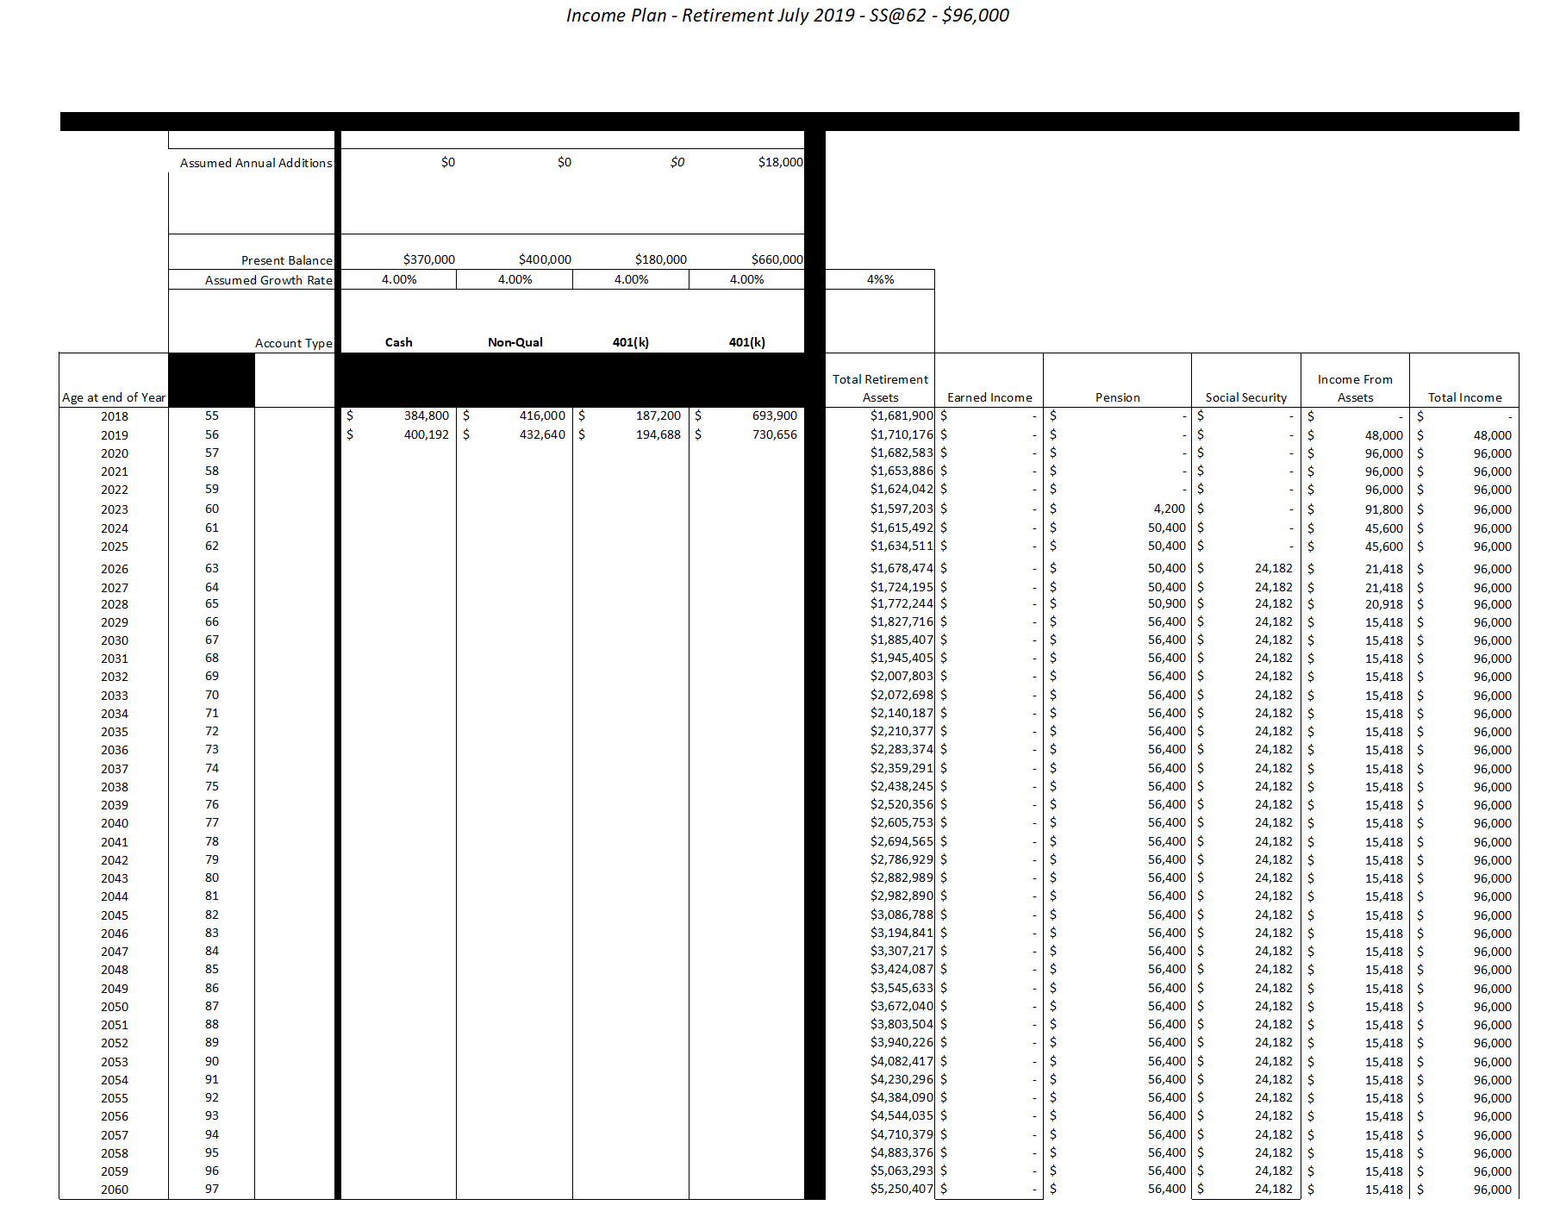
Income Plan: Retirement July 2019 – SS@62 – $96,000

Slide 209
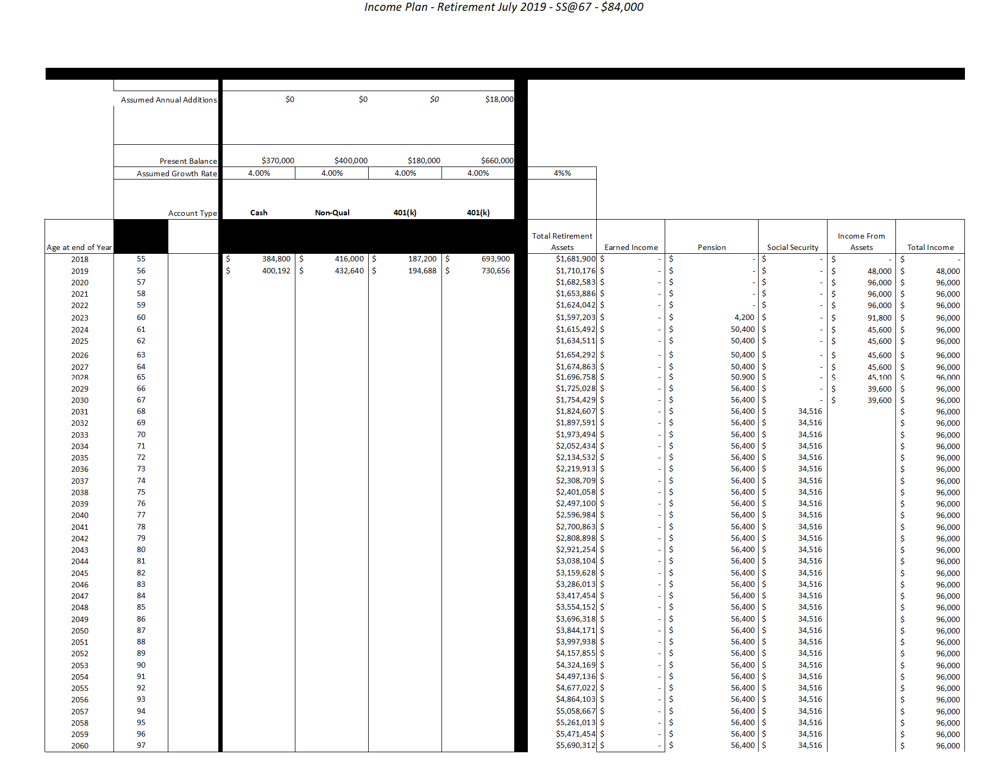
Income Plan: Retirement July 2019 – SS@67 – $96,000

Slide 210
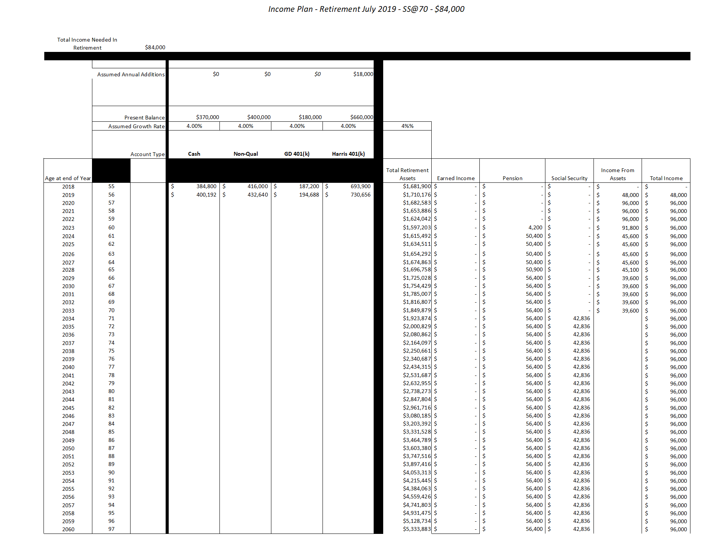
Income Plan: Retirement July 2019 – SS@70 – $96,000

Slide 211
62
67
70
Based on our 4% growth assumptions, in the context
of this income model, at age 78, collecting Social Security is a better choice than collecting
at age 62.
Collecting Social Security at age 70 may not be the best choice.

Slide 212
Designing the Revenue Sourcing™ Allocation Map
When the Income Map has been designed, determine the level of funding needed for stable assets and inflation protection assets
Analyze Feasibility

Slide 213
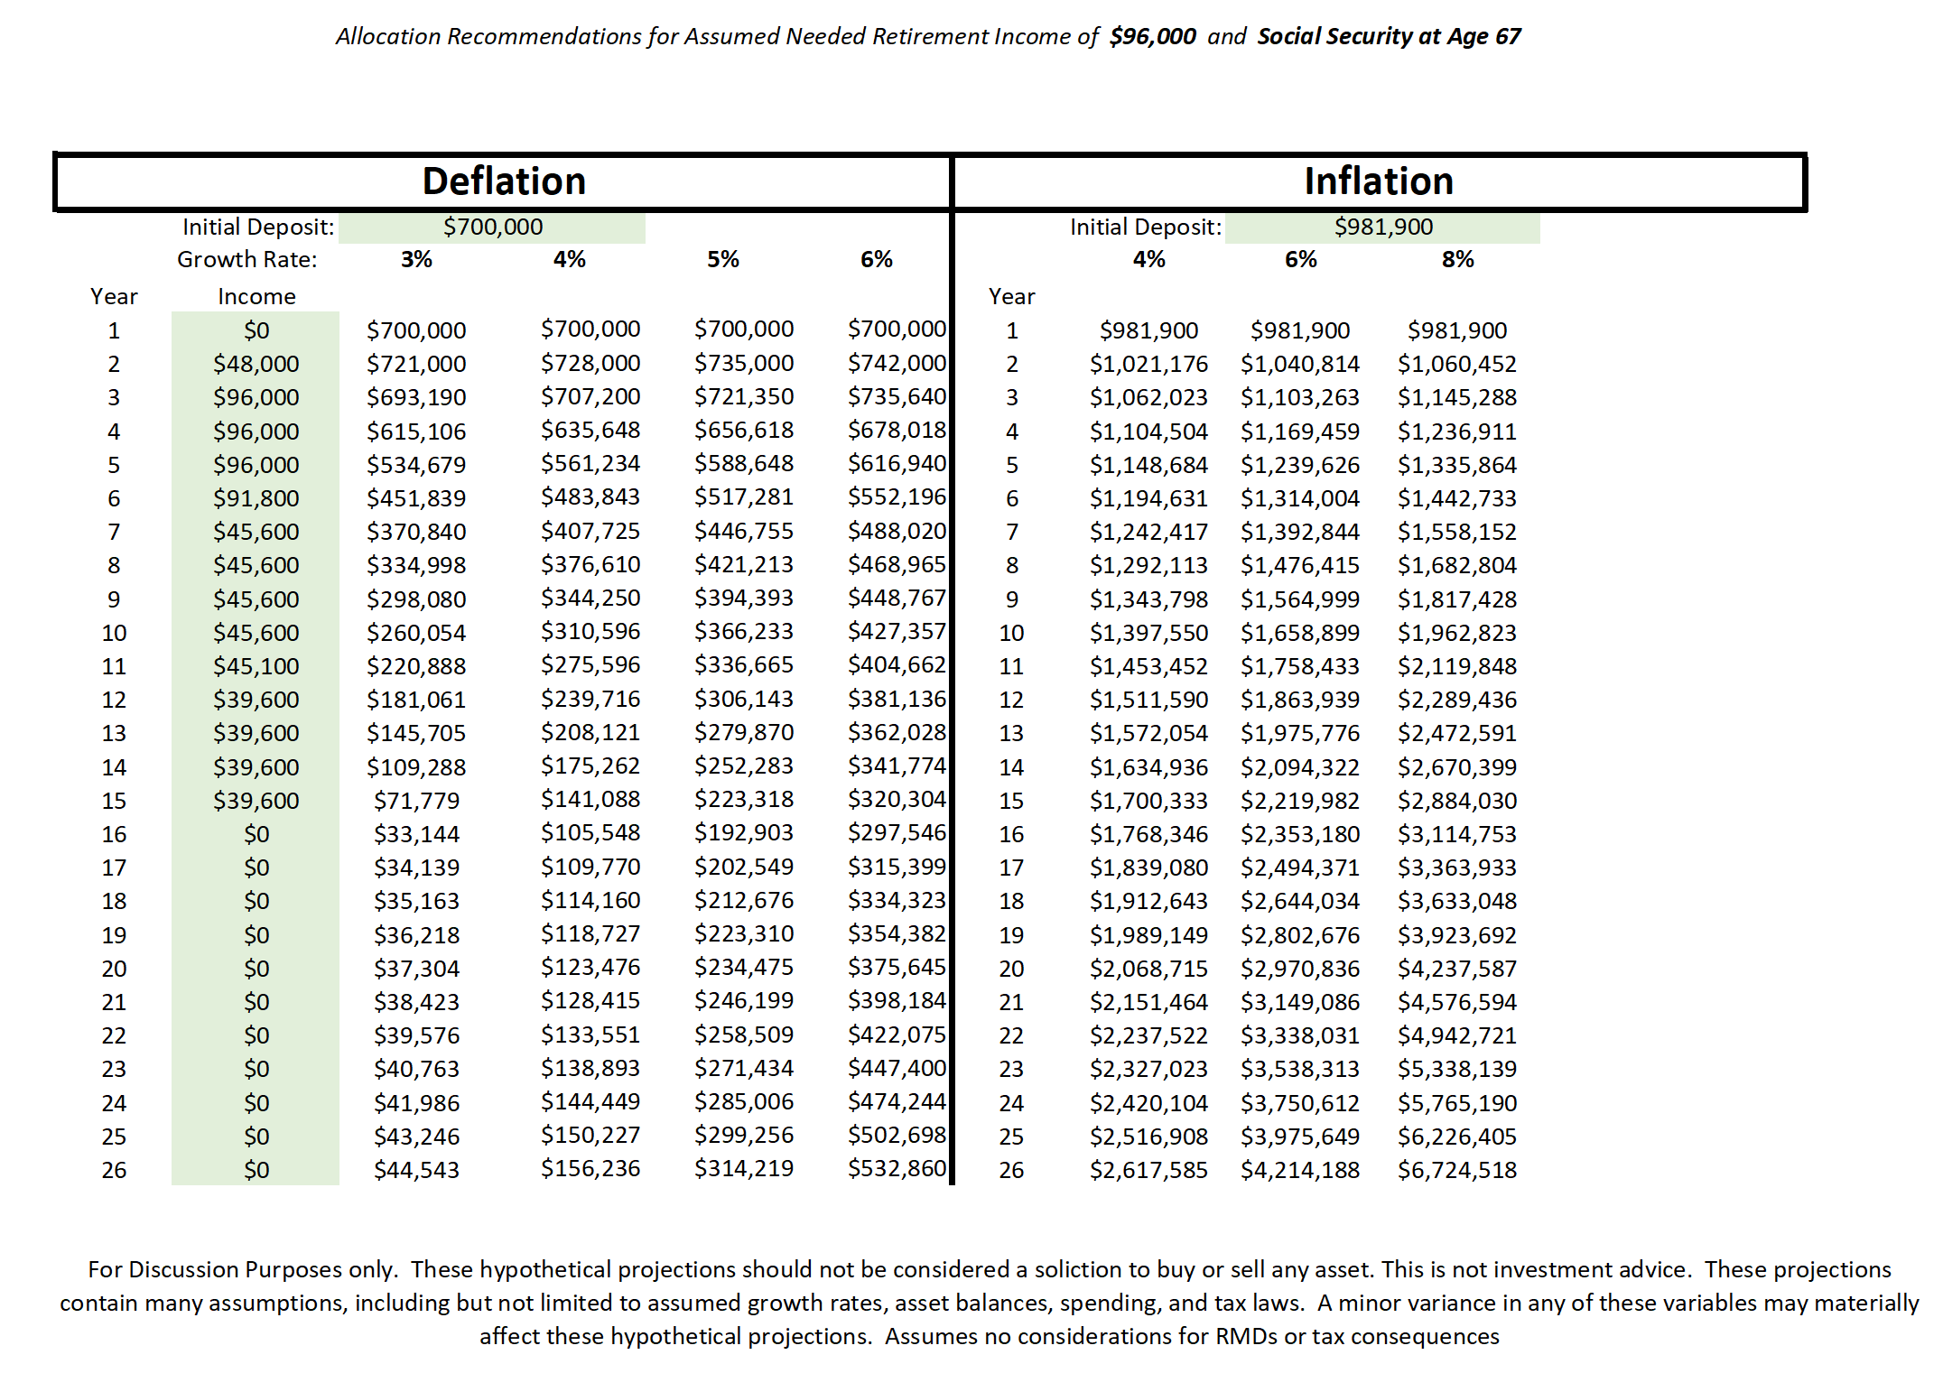

Slide 214
Income Planning Risk
A Threat to Income: Drawdown

Slide 215
Why Managing Drawdown is Important
Buy and Hold Results

Slide 216
Why Managing Drawdown is Important

Slide 217
Do You Know the Drawdown Risk In Your Portfolio?

Slide 218
Income Planning Risk:
Excessive Fees in Investments
“Money Managers and Advisors
Get Paid Before You Do”

Slide 219
$508,404
$4,402
$-156,089

Slide 220
Additional Fee Paid to Broker/Advisor 1%
$5,084
Total
Fees
$9,486

Slide 221
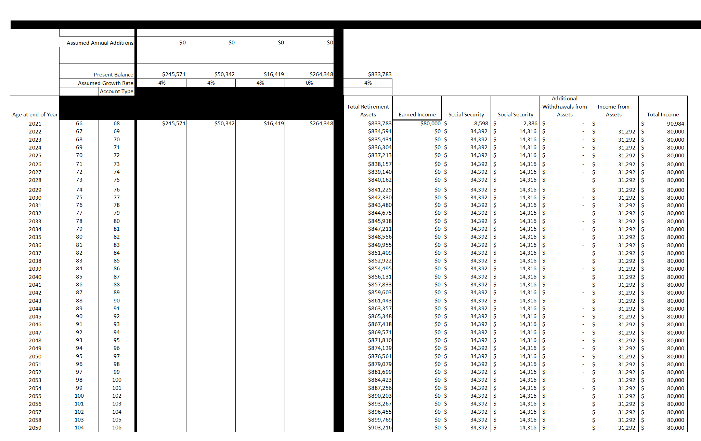
$80k Income – No Drawdown

Slide 222
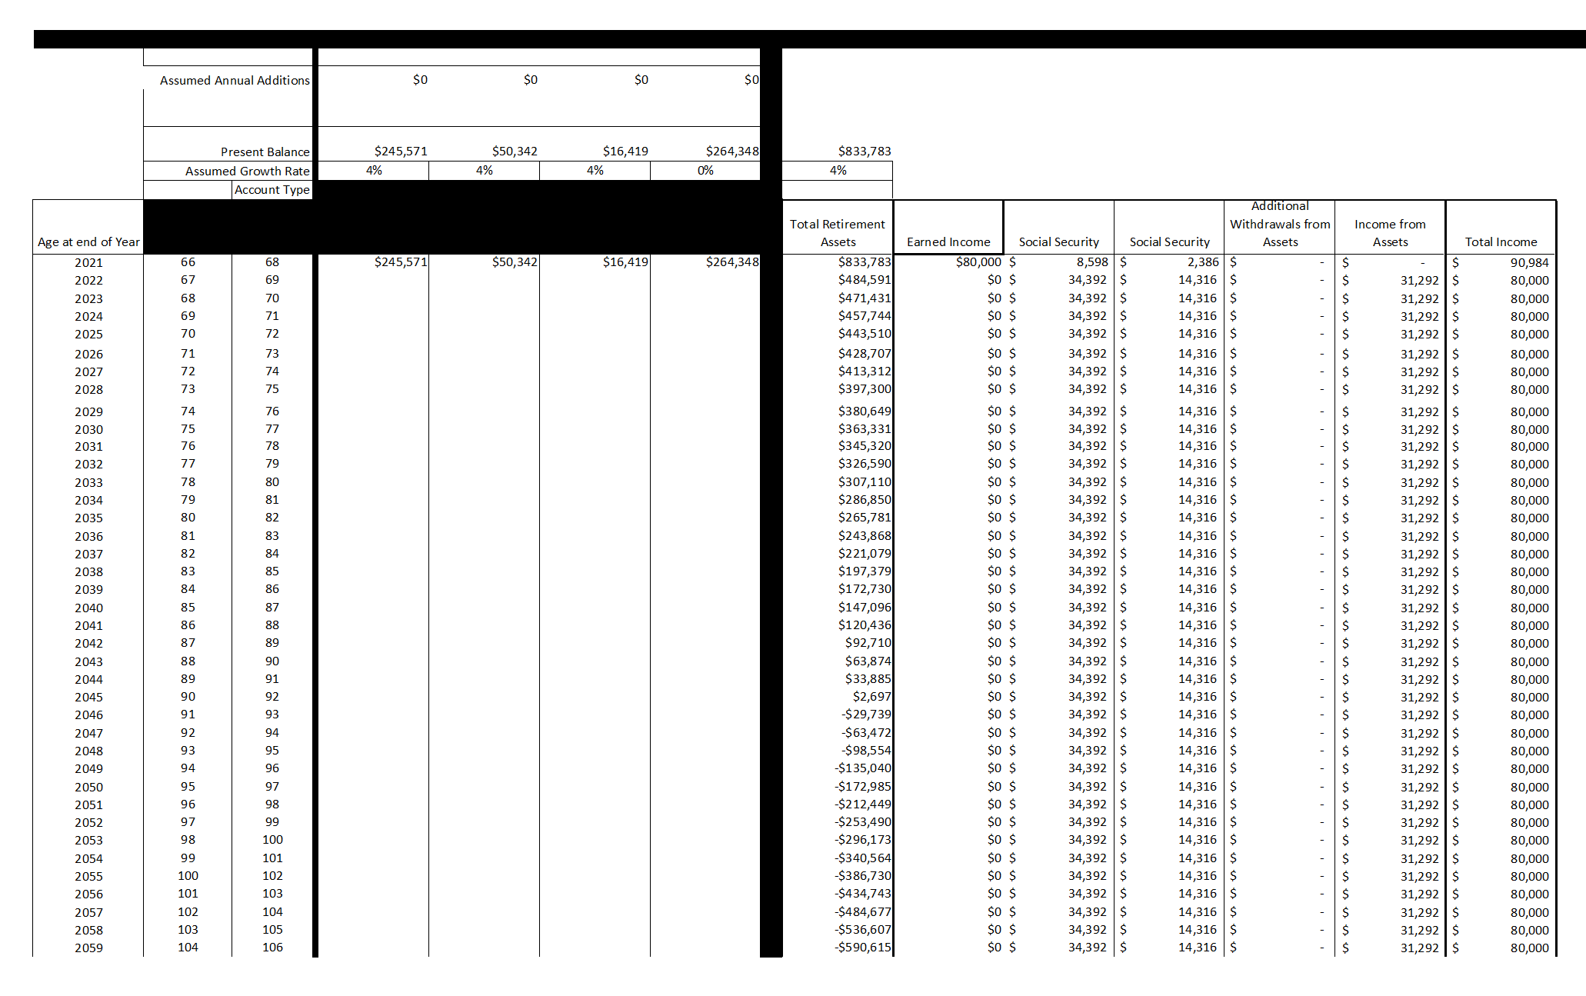
$80k Income – 50% Drawdown

Slide 223
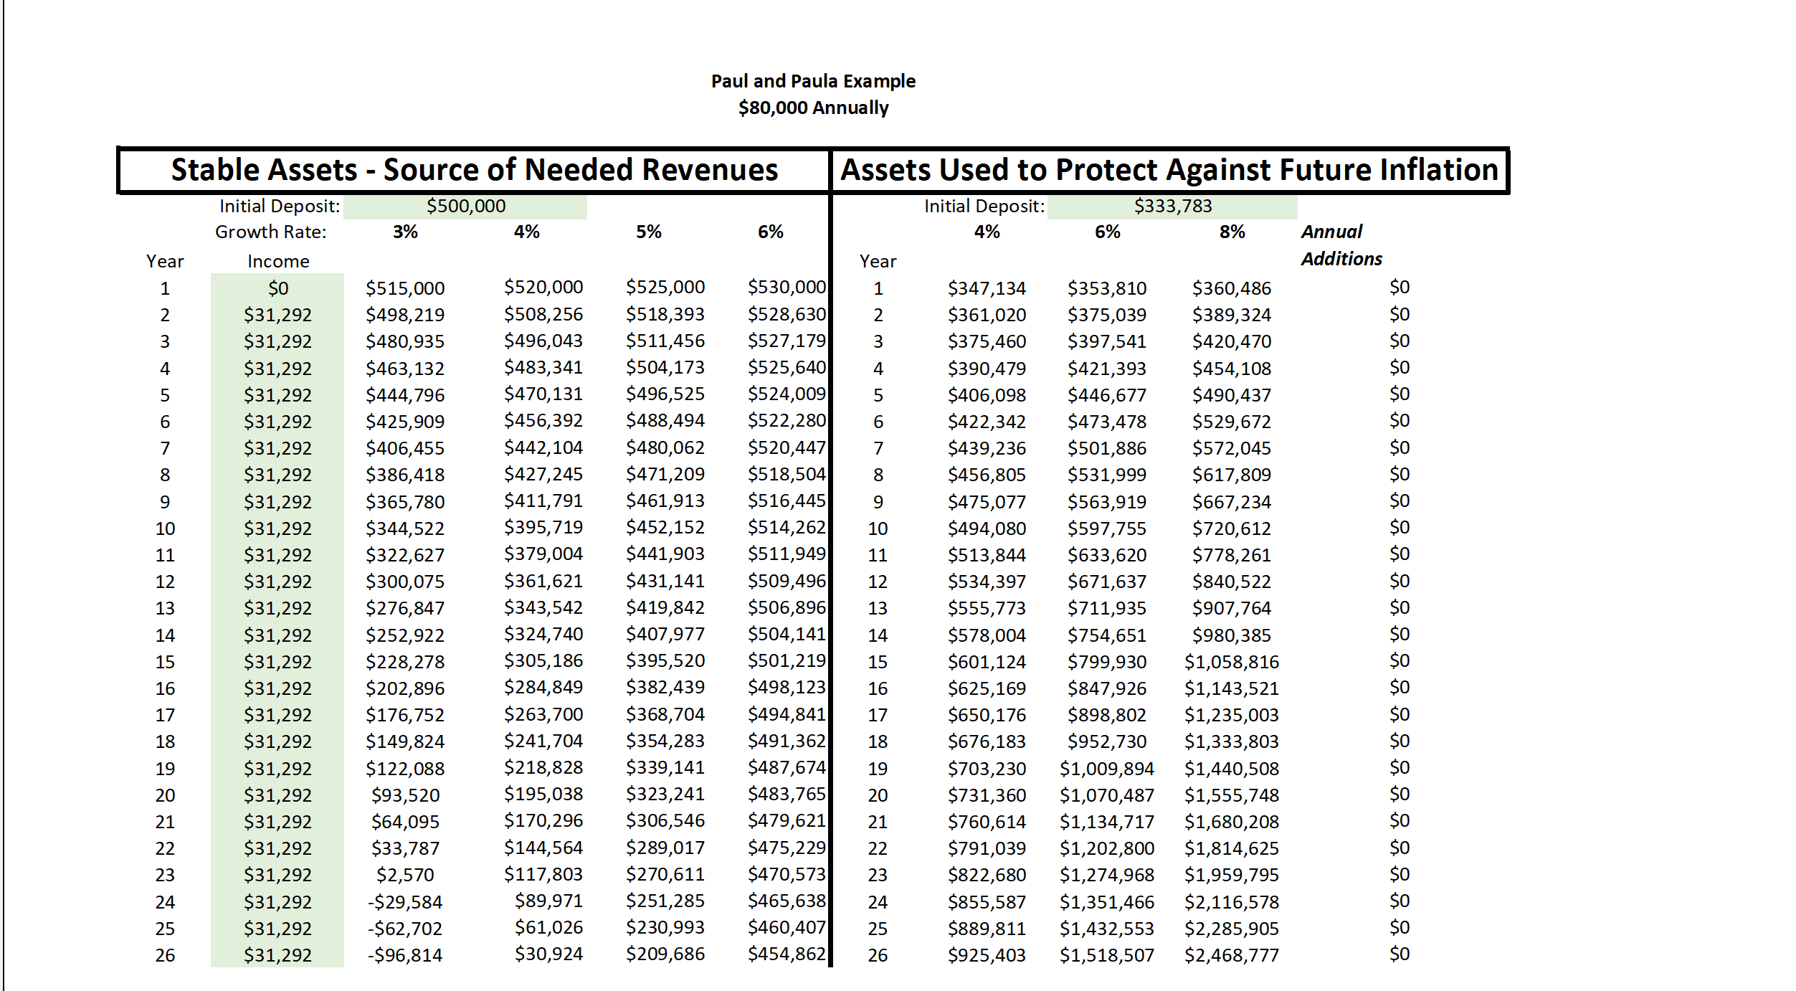
Allocations

Slide 224
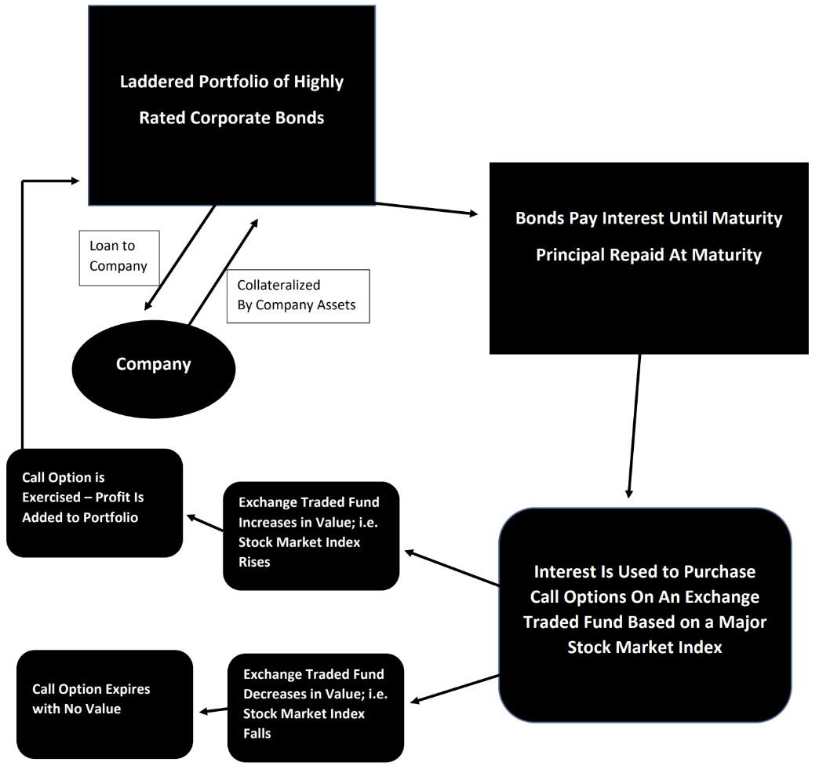
Stable Asset Strategy
Managed Risk

Slide 225
Inflation Hedge Strategy
Precious Metals
  Bullion
  Non-Collector Circulated Coins
  Rare Coins
Owning Metals in an
IRA or Roth
  Custodian
  Approved Depository
  Allowed Purchases

Slide 226



Bullion and Bullion Coins

Slide 227
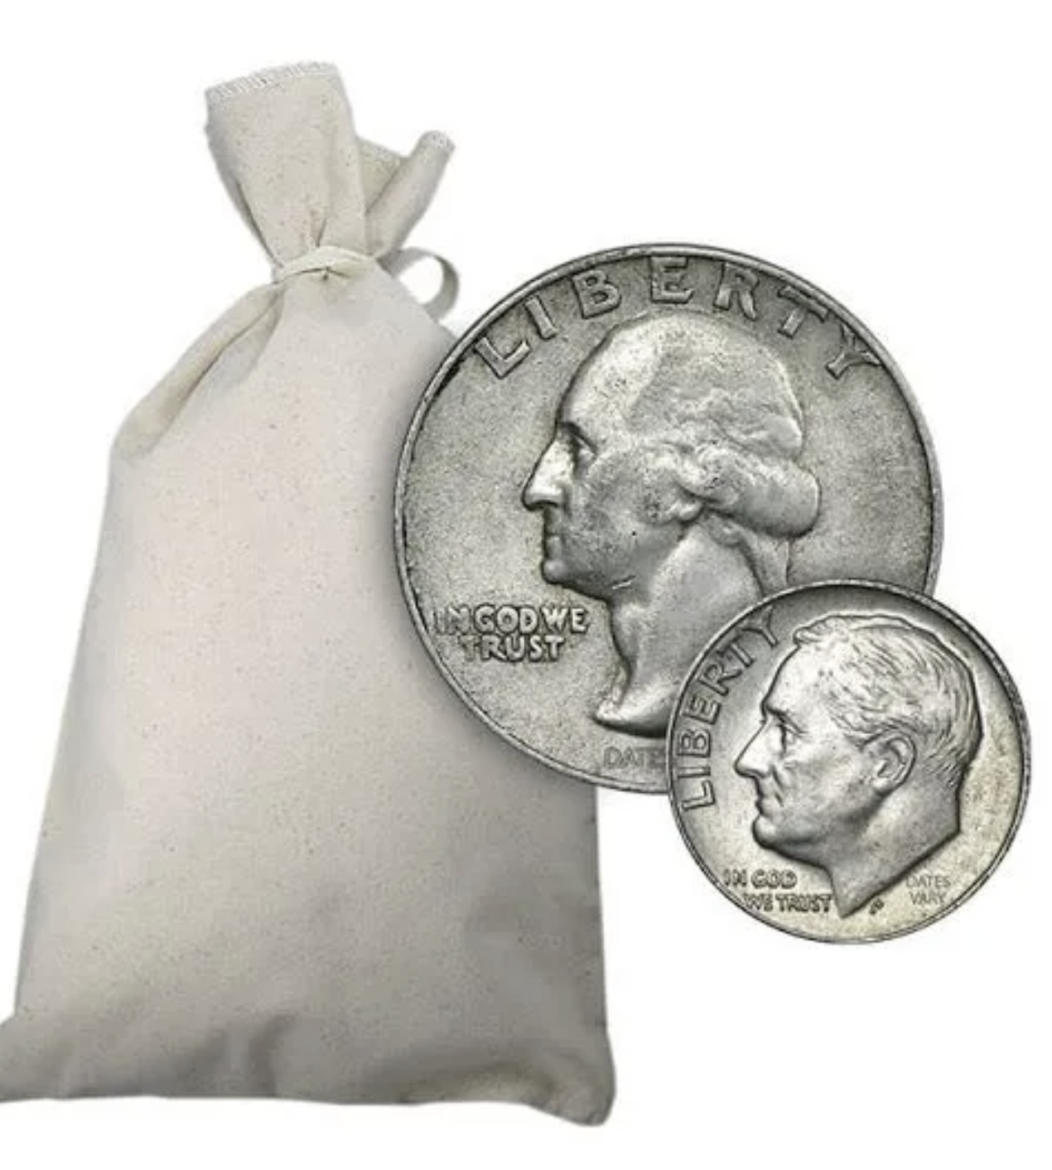

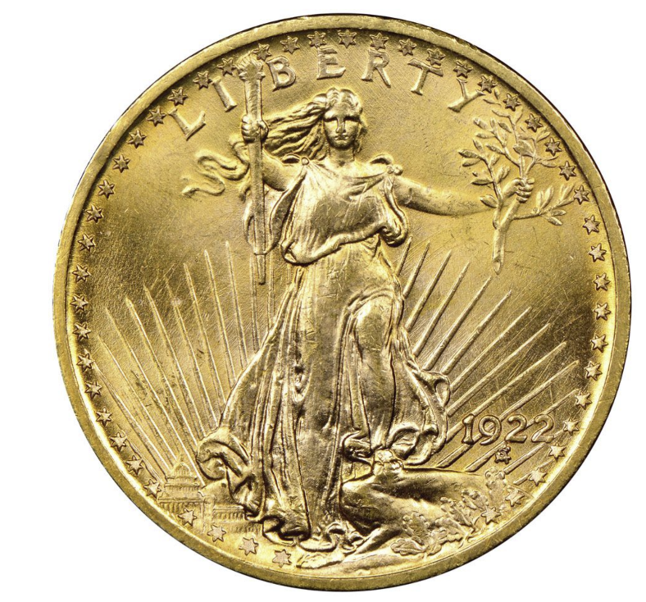
Non-Collector Circulated Coins

Slide 228
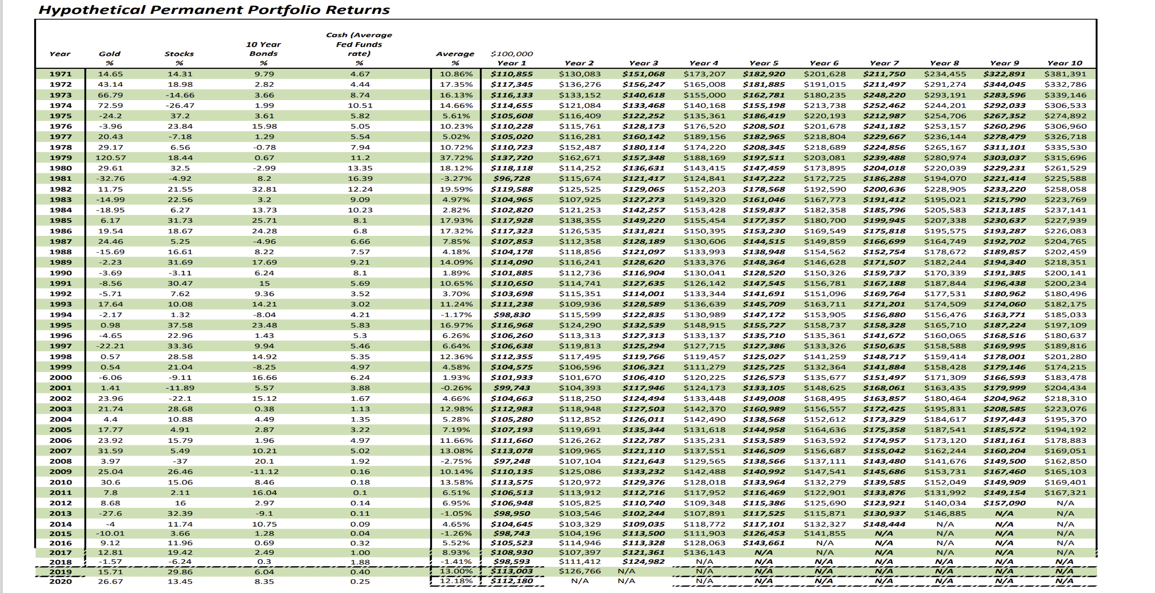
Inflation Hedge Strategy

Slide 229
Estate Planning

Slide 230
Definitions
Will: Written List of Instructions to the probate court
Probate: Court supervised process of wrapping
up a person’s estate

Slide 231
Definitions
Durable Power of Attorney:
Appointed to make business decisions
Durable Healthcare Power of Attorney:
Appointed to make healthcare decisions

Slide 232
Definitions
Revocable Living Trust:
Legal entity that owns assets and describes how your assets will be distributed after your death

Slide 233
Dynastic Trust Planning

Slide 234

Wouldn’t It Be
If Your Estate Plan Not Only

Slide 235

      Avoided or
      minimized probate.
Which is where many estate plans stop.

Slide 236

But also…
      Helped to protect your assets from a lawsuit during your lifetime;

Slide 237

      Continued to manage your assets after your heirs inherit them in any manner that you dictated;

Slide 238
      Would continue to protect those assets if your heirs were a victim in a lawsuit;

Slide 239

      Would also protect those assets in the event that one of your heirs got divorced;

Slide 240

      Would allow your heirs to buy their homes, vacation homes, cars and anything else using these trust assets (and still protect them in the event of a lawsuit or divorce);

Slide 241

      Would allow your heirs to pass along those same assets to their heirs with all the same lawsuit and divorce protection; and

Slide 242
      Would allow this process to potentially continue from one generation to the next for the next
      10-12 generations?

Slide 243
      This IS Possible…
But, sadly most estate planners don’t put this type of plan into effect.

Slide 244
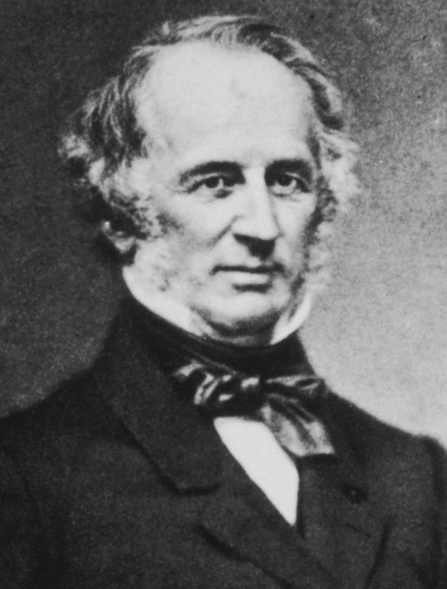

Take the example of the family of Commodore Cornelius Vanderbilt who died with a fortune of $105,000,000 that he left largely to his oldest son William in the year 1877.
  Source: www.truthbeknown.com

Slide 245
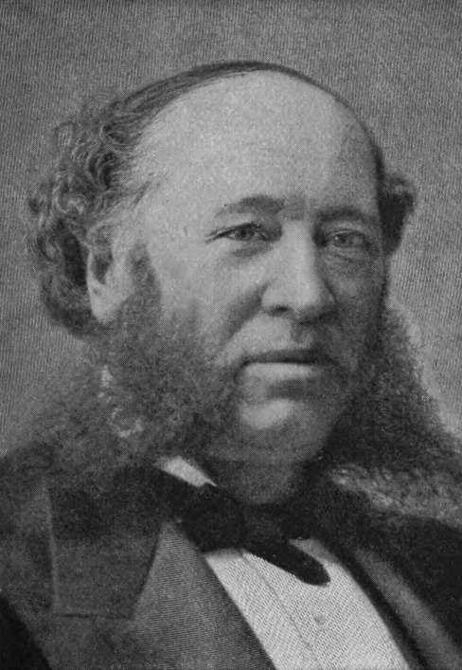
William did a good job managing the assets left to him by his father. When William died 8 years later in January 1885, William was worth $200,000,000.
  Source: www.truthbeknown.com

Slide 246
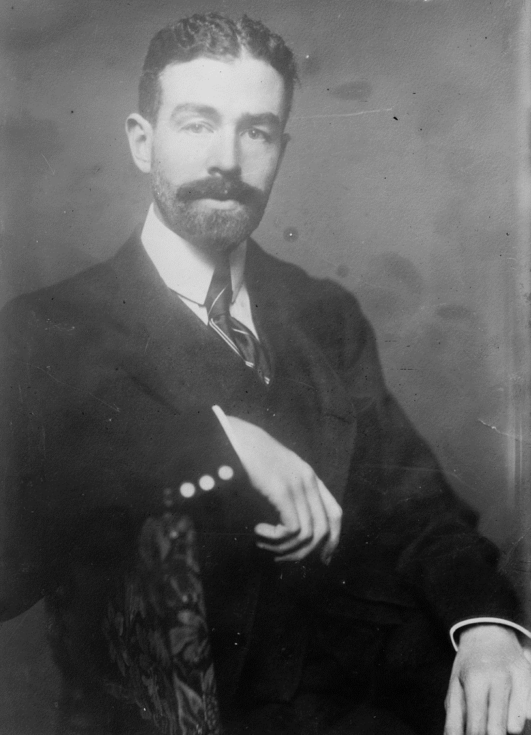
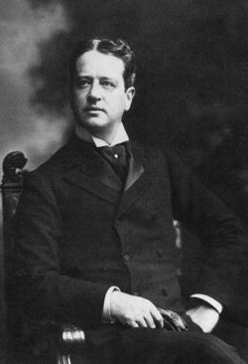
William left half his fortune
to his 2 sons, Cornelius and William K, bringing their fortunes to $50,000,000 each and the remaining $100,000,000 was divided among his other children.

Slide 247
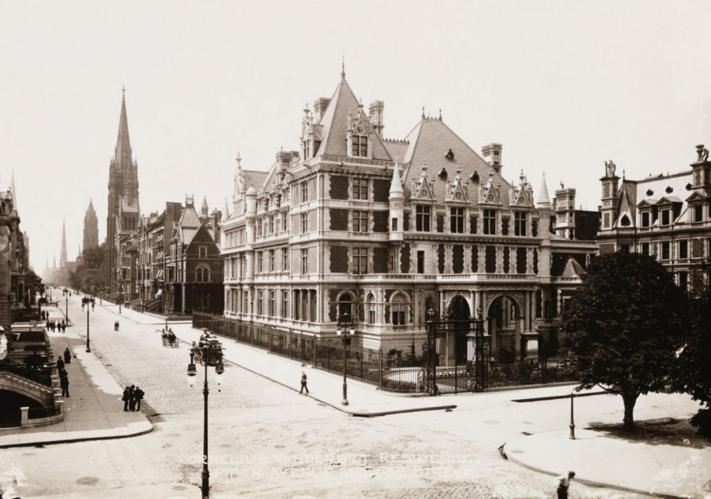
Many of the heirs
of William H. began spending their inheritance on lavish residences. Cornelius spent over $6,000,000 in 1886 to build a residence in
New York City.
  Source: www.truthbeknown.com

Slide 248
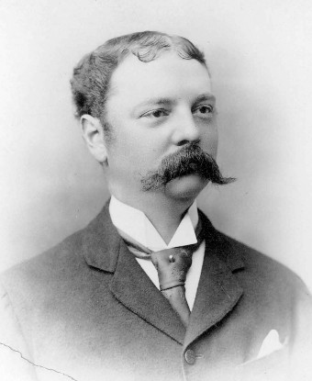
Of all William H’s children, Frederick, who inherited only $10 million, did the best financially. At Frederick’s death in 1938, he was worth $78 million. However, federal estate taxes consumed over half his estate.
  Source: Parknet.Com. National Park Service

Slide 249
The succeeding generations of Vanderbilts didn’t do as well.

Slide 250
According To Arthur T. Vanderbilt II, author of
“Fortune’s Children: Fall Of The House Of Vanderbilt”,
when 120 of Commodore Cornelius Vanderbilt’s direct descendants gathered for a reunion in 1973 – there was not a millionaire among them.

Slide 251
Only 3%
of family assets on average survive to
the 4th generation.
  Source: Family Firm Institute, Brookline, Massachusetts

Slide 252
By now, you should realize that the centerpiece of any estate plan should be a multi-generational trust for your descendants that is:
  Estate Tax Protected
  Creditor Protected
  Divorce Protected
Even though the primary beneficiary of the Trust controls the trust as trustee.

Slide 253
Let’s go back and revisit Commodore Cornelius Vanderbilt’s estate.
What if the commodore had utilized a multi-generational trust?

Slide 254
Let’s assume a 4% net return on assets after withdrawals by the heirs, and see what the assets might be worth today:
Year | Estate Value
1877 | $ 105,000,000
1910 | $ 398,403,216
1935 | $ 1,062,077,767
1965 | $ 3,444,740,085
2022 | $58,017,219,834

Slide 255
Different states allow dynastic trusts to continue for a different number of years
Nevada allows a dynasty trust to last for 365 years.
Florida allows a dynasty trust to last for 360 years.
Many states are currently “Life in being plus 21 years”. Death of youngest living beneficiary plus 21 years – typically 90 – 120 years

Slide 256
Leaving an IRA to Your Heirs vs. a Roth

Slide 257
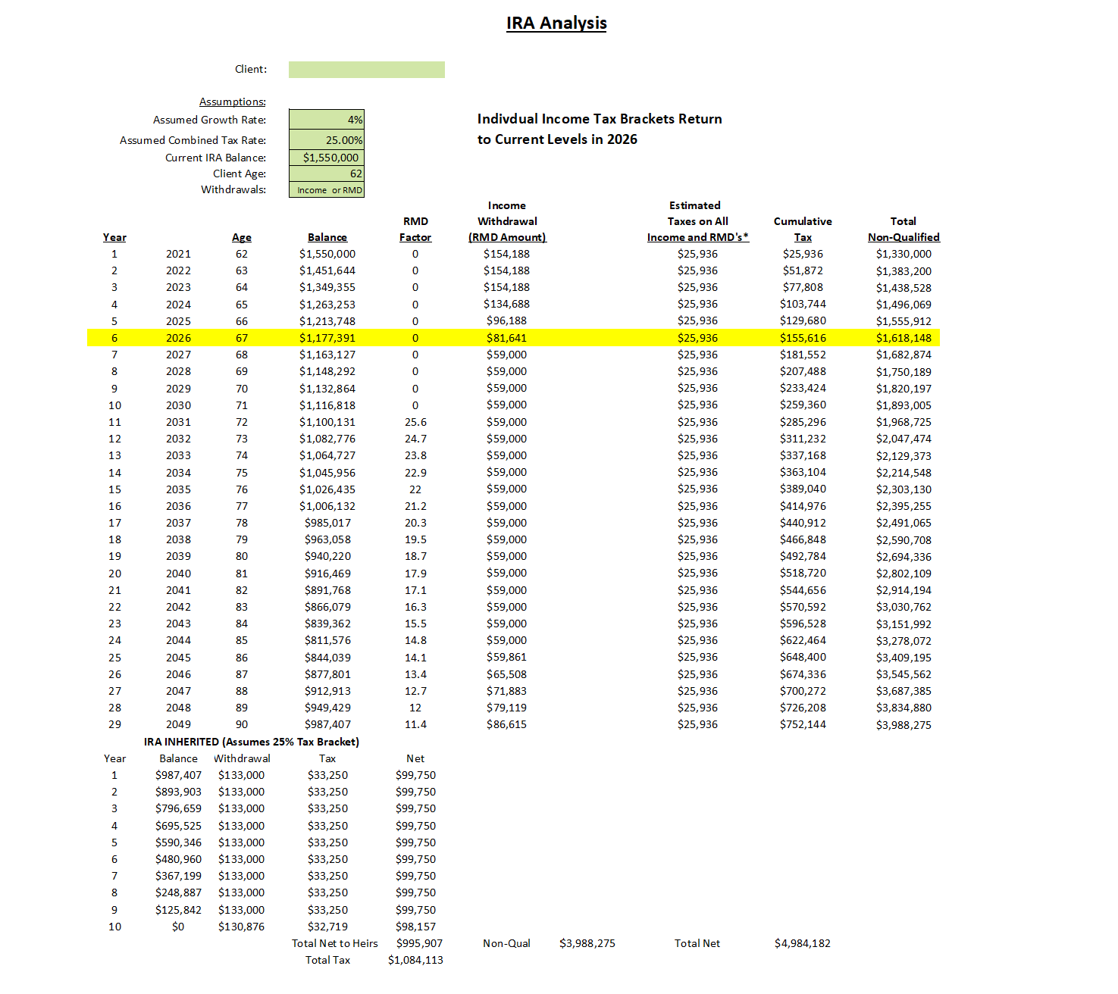
Actual Client from 2021

Slide 258
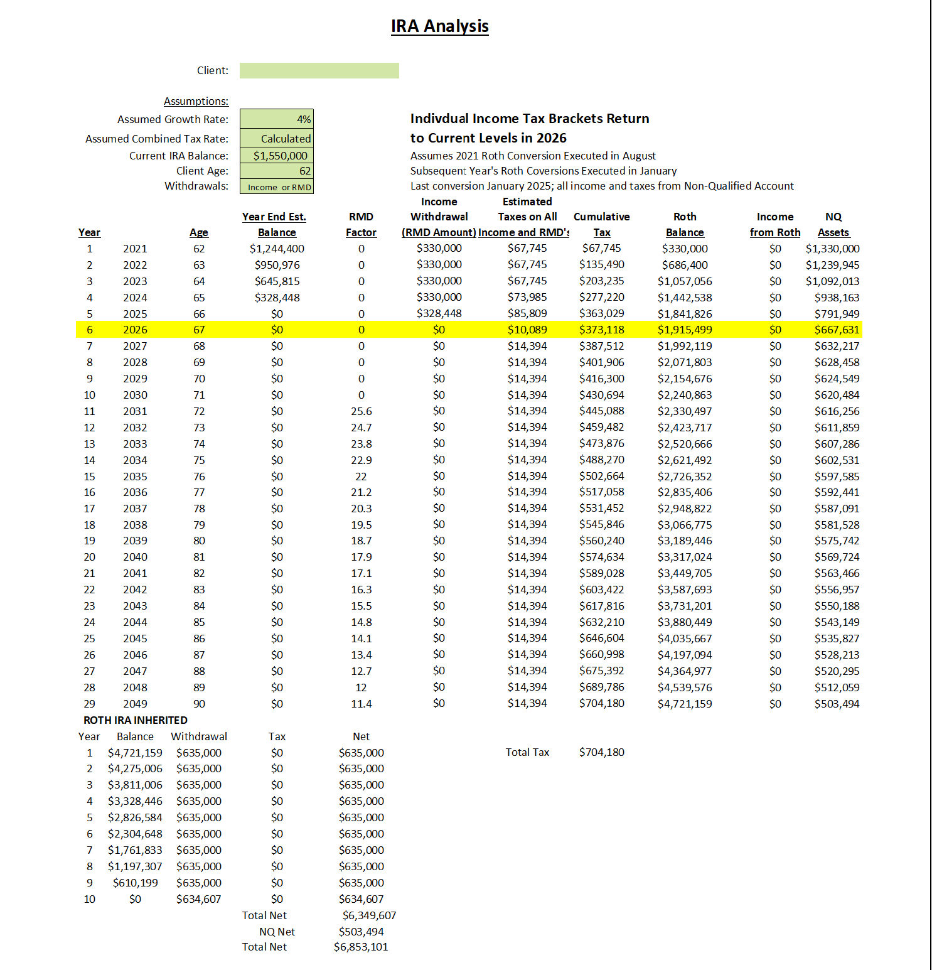
Actual Client from 2021

Slide 259
Protecting Assets from the Risk of a Large Medical Expense
The Potential Problems with Traditional Long Term Care Insurance
  May not keep pace with inflation
  Premiums can increase without additional benefits

Slide 260
Protecting Assets from the Risk of a
Large Medical Expense
Potential Alternative…..
Linked Benefit
Contract

Slide 261
Protecting Assets from the Risk of a Large Medical Expense
Example:
  75-Year-Old Female Client
  Annual Deposit: $4,873
  Guaranteed Benefit: $210,000
Can be used for medical expenses if chronically ill or will be paid as a tax-free death benefit at her passing.

Slide 262
Module Three:
Taxation of Benefits and Retirement Accounts (Review)

Slide 263
In this example, we’ll consider the situation of Frank and Susan. They are both 66 years old.

Slide 264
They’ve done some preliminary planning and determined that they will need about $84,000 per year when they retire.

Slide 265
After conducting a Social Security maximization study, they determine that they can receive a combined $58,000 per year from Social Security upon retirement.

Slide 266
Frank and Susan have accumulated $1,200,000 in 401(k) plans at their employers. They will need to draw $26,000 per year from these assets to meet their desired income level.
$26,000
Needed
$34,000
Frank Social Security
$58,000
Total Benefits
$24,000
Susan Social Security

Slide 267
One look at Frank and Susan’s situation reveals that when they reach age 72, their required minimum distributions will exceed their income needs.

Slide 268
Income Frank and Susan will need during retirement followed by required minimum distributions.
Age 72
RMD’s
$53,492

Slide 269
Let’s examine how those withdrawals will affect Frank and Susan’s Social Security benefits when they reach age 72 (Now changed under the SECURE Act).

Slide 270
RMD’s $53,492
Taxable Social Security $38,718
Tax $7,546

Slide 271
Now, let’s review Frank and Susan’s tax return at their age 85 based on these assumptions.

Slide 272
RMD’s $78,879
Taxable Social Security $49,300
Tax $16,187

Slide 273
Because of the level of IRA withdrawals that are required, Frank and Susan pay taxes on an ever- increasing portion of their Social Security benefits. Social Security taxes increase until 85% of Social Security Benefits Received are taxable.

Slide 274
IRA Analysis

Slide 275
Now, let’s assume that Frank and Susan decide to do Roth IRA conversions or a similar strategy to reduce the total taxes they’ll pay over their lifetime.

Slide 276
IRA Analysis RMD’s Only

Slide 277
Regular IRA
Tax Free
Alternative
$627,834
$324,231
Here is the potential tax savings for Frank and Susan when the divorce themselves from the IRS when taking into account Social Security tax savings as well
Tax Savings
$303,153

Slide 278
Now let’s compare income tax returns at age 72.

Slide 279
Before
RMD’s $53,492
Taxable Social Security $38,718
Tax $7,546

Slide 280
RMD’s $0
Taxable Social Security $0
Tax $0
After

Slide 281
Distributions from a Roth IRA or a properly designed guaranteed insurance contract are tax free and do not count in the formula that is used to determine how much of one’s Social Security is taxed.
A Portion of the Roth Conversion Could Be Redirected to a Linked Benefit Contract with High Cash Values

Slide 282
Module Four:
Income Planning
(Review)

Slide 283
Case Study

Slide 303
You'll Receive These Free Reports:
  Social Security Maximization Report
  Fee and Drawdown Analysis Report
  IRA and 401(k) Tax Analysis
  New Retirement Rules Income Sourcing Map
  New Retirement Rules Allocation Map

